Slide 1
React
If you’ve worked on frontend JavaScript applications in the past two years, you’ve probably heard of React.
React is a library for creating user interfaces that was initially built and open sourced by Facebook.
It’s a JavaScript library built with simplicity, performance, and components in mind.
It allows you to choose how to implement your data models, server calls, and other application concerns, and what to implement them with.
React can be a great tool for small and large applications and teams.
there are many popular applications that use React.

Slide 2
Components
Vue, Preact, Angular, Ember, Webpack, Redux and other well-known JavaScript libraries and frameworks.
Major part of frontend applications and shares similar features with the other libraries
React’s is very powerful on functional and object-oriented programming concepts and focuses on components as primary units.
Components utilize data (properties and state) to render your UI as output.
Certain types of React components also provide a set of lifecycle methods.
Components in React should be easy to think about and integrate with other React components.
In React applications, you create interfaces from Components.

Slide 3
Components often correspond to aspects of the user interface, like date-pickers, headers, nav-bars, and others, but they can also take.
Components can maintain their own internal state, and work with “regular old JavaScript.
The rendering process (outputting and updating a UI based on your data) is predictable in React, and your components can hook into it using React’s APIs.
React doesn’t just use a novel approach to dealing with changing data over time.
focuses on components as a paradigm for organizing your application
Components are the most fundamental unit of React. There are several different ways you can create components with React

Slide 4
Components in React: Encapsulated and reusable
React components are well encapsulated, reusable, and composable
characteristics help enable a simpler and more elegant way of thinking about and building user interfaces.
when you work with components in React it will be important to consider organization and consistency in component design.
You’ll want to design components that are self contained and focus on a particular concern or a handful of related concerns.
Breaking your UI into components allows you to work more easily on different parts of the application.
components that are portable, logically grouped, and easy to move around and reuse throughout your application.

Slide 5
Components in React are meant to work together.
This means you can compose together components to form new composite components.
Component composition is one of the most powerful aspects of React.
You can create a component once and make it available to the rest of your application for reuse.
This is often especially helpful in larger applications.
If you’re on a medium-to-large team, you could publish components to a private registry (npm or otherwise) that other teams could easily pull down and use in new or existing projects.

Slide 6
React libraries
React uses a set of core libraries. The core React library works with the react-dom and react-native libraries and is focused on component specification and definition.
It allows you to build a tree of components that a renderer for the browser or another platform can use.
React-dom is one such renderer and is aimed at browser environments and server-side rendering.
The React-native libraries focus on native platforms and let you create React applications for iOS, Android, and other platforms.
Running a React application
Your React application runs on the platform you’re building for focuses on the web platform and builds a browser and server-based application. For way shopping
React is a declarative, component based library for building user interfaces that works on a variety of platforms: web, native, mobile, server, and desktop.

Slide 7
Third party libraries—
React doesn’t enforce opinions on you data modeling, HTTP calls, specific areas of styling such as look and feel, or other aspects of your application.
For these, you’ll integrate other technologies to build out your application as you see fit.
Not all libraries are compatible with React.

Slide 8
THE VIRTUAL DOM
A virtual DOM is a data structure or collection of data structures.
In general, a virtual DOM will serve as an intermediate layer between the application code and the browser DOM.
The virtual DOM allows the complexity of change detection and management to be hidden from the developer and moved to a specialized layer of abstraction.

Slide 9
what is the DOM?
The DOM, or Document Object Model, is a programming interface that allows your JavaScript programs to interact with different types of documents (HTML, XML, and SVG).
The DOM provides a structured way of accessing, storing, and manipulating different parts of a document.
the DOM is mostly synonymous with web browsers like Chrome, Firefox, and Edge
At a high level, the DOM is a tree structure that reflects the hierarchy of an XML document.
Whenever you use a method in JavaScript that accesses, modifies, or stores information related to something in an HTML document.

Slide 10
Common methods or properties you may have used to update or query a web page might include getElementById, parent.appendChild, querySelectorAll, innerHTML, and others. These are all provided by the host environment (in this case,the browser).
and allow JavaScript to interact with the DOM
Interacting with the DOM is usually straightforward but can get complicated in the context of a large web application.
Fortunately, we don’t often need to directly interact with the DOM when building applications with React—we mostly leave that to React.
React’s implementation of a virtual DOM Without web API, React can’t work.
When data changes, we want to update the UI to reflect that can be difficult, so React aims to solve that problem.
browsers handle interactions with the DOM. When a DOM element is accessed, modified, or created, the browser is often performing a query across a structured tree to find a given element.

Slide 11
How does the virtual DOM work?
React’s virtual DOM has a few similarities to another software world: 3D gaming. 3D games sometimes employ a rendering process that works very roughly as follows.
get information from the game server, send it to the game world.
React creates and maintains a virtual DOM in memory
ReactDOM handles updating the browser DOM based on changes

Slide 12
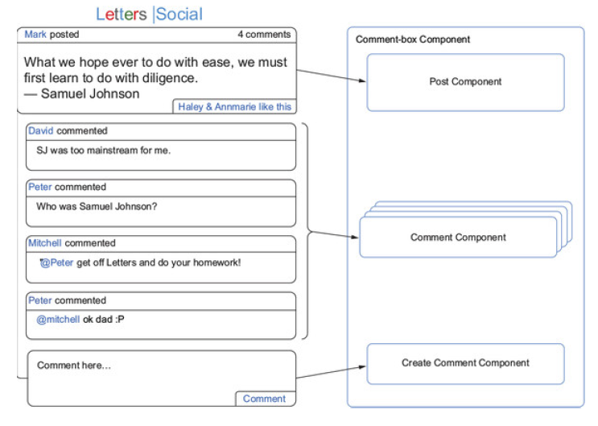
Components in general

Slide 13
benefits of React
Individual developer— Once you learn React, your applications can be easier to rapidly build out. They will tend to be easier to work on for larger teams, and sophisticated features can be easier to implement and maintain.
Engineering manager— There’s an initial cost for developers as they learn React, but eventually they’ll be able to more easily and quickly develop complex applications.
CTO or upper management— React, like any technology, is an investment with risks. But the eventual gains in productivity and reduced mental burdens often outweigh time sunk into ramping up. That’s not the case for every team, but it’s true for many.

Slide 14
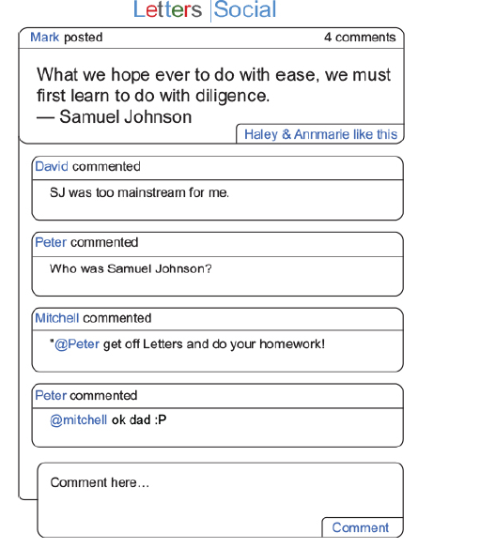

Slide 15
How should you get started building this?
begin with understanding the data your application needs and then seeing how you can turn that into components.
How should you translate the mockup into components?
You could just dive in and start trying to create components without knowing anything about React.
but without understanding how they work or what purpose they’d serve.
We’ll do some planning in the next few sections so you have a better idea about how to structure and design your comment box.

Slide 16
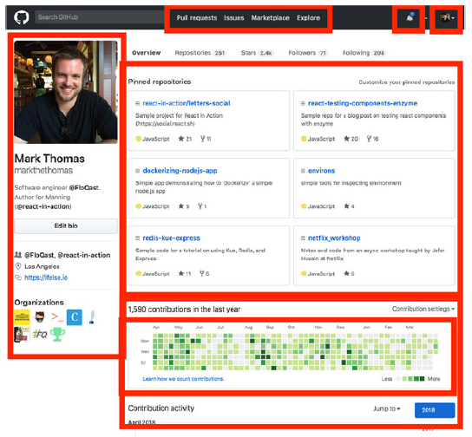

Slide 17
Understanding the application data
we need something else before we can plan how your components will be organized.
We need to know what information the API will provide to your application.
Based on the mockup, you can probably already guess some of the data that you might be getting back.
Getting a sense of the shape of your application data will be an important part of the planning we’re doing before starting to create your UI.

Slide 18
Multiple components
We need to know how components can be organized with other components.
React components are organized into tree structures.
Like DOM elements, React components can be nested and can contain other components.
They can also appear “next to” other components, which means that they occur at the same level as other components.
Components can have different types of relationships (parent and child).
can be used to create other components or can even stand alone.
They can often be easily moved around because they’re self-contained and don’t carry any baggage when moved

Slide 19
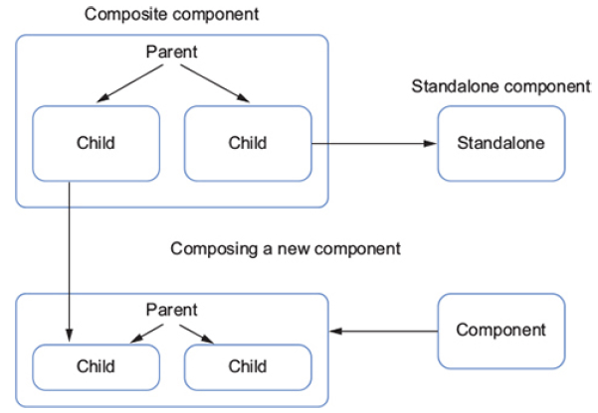

Slide 20
what sort of relationships can components have?
few different types of relationships that can be created using components.
Components can be used in flexible ways. Because they’re self-contained.
Composable components are often easily moved around and can be reused to create other components.
Because of components are composable, they can be used in many places throughout our application.
Wherever a component is used, it is having certain type of relationship: parent and child.
If a component contains another component, it’s said to be the parent.
A component within another component is said to be a child.
Components that exist at the same level don’t share any sort of direct relationship.
Even though they might be right next to each other. They only “care” about their parents and children.

Slide 21
Establishing component relationships
Now you can get started on defining your component hierarchy, which is the process of applying what you’ve learned so far.
You’ll establish what will be a component and where it will go.
This process of establishing component relationships won’t look the same for every team or every project.
Ensure that components are grouped together in a way that makes sense.
components should be organized around related functionality.

Slide 22
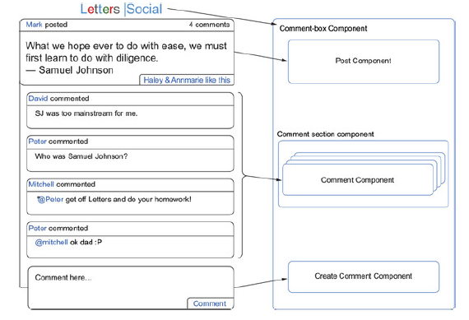

Slide 23
We’ve come up with four components.
React enforces a parent-child relationship between components.
you’re free to define your hierarchy in whatever way makes the most sense to you and your team.

Slide 24
CREATING COMPONENTS IN REACT
In this section, you’ll create some React components and run them in a browser.
you won’t need to use node.js or any anything else to get everything set up and running.
You’ll run code in the browser via CodeSandbox (https://codesandbox.io).
You’ll use three libraries for your first components: React, React DOM, and proptypes.
React DOM is a renderer for React that was split off from the main React library to better separate concerns;
it handles rendering components to the DOM or a string for server-side rendering.
The prop-types library is a development library that will help you do some type-checking on data passed to your components.

Slide 25
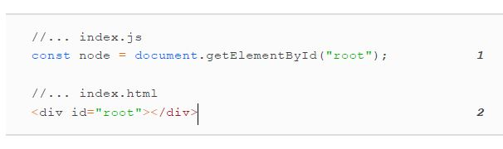
You’ll start creating the comment box component by creating some of the constituent parts first.
React creates and renders your components.
You need to add a new DOM element with an ID of root as well as some basic code that uses React DOM.
your code won’t do much of anything except download the React libraries and find the root DOM element.
To make something substantial happen, you need to use React DOM.
You’ll need to call its render method for React to create and manage your component.

Slide 26
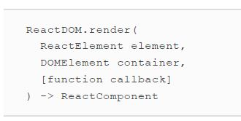
React DOM needs an element of type React Element and a DOM element.
created a valid DOM element that you can use, but now you need to create a React element.
what’s a React element?
A React element is a light, stateless, immutable primitive in React.
There are two types: ReactComponentElement and ReactDOMElement.

Slide 27
ReactDOMElements are virtual representations of DOM elements.
ReactComponentElements reference either a function or a class corresponding to a React component.
Elements are the descriptors we use to tell React what we want to see on the screen and
Most of your components will be collections of React elements.
When you’re creating plain old HTML markup, you use a variety of element types (div, span, section, p, img, and so on) to contain and structure information.
In React, you can use React elements
which tell React about either React components or regular DOM elements you want rendered—to compose and build your UI.

Slide 28
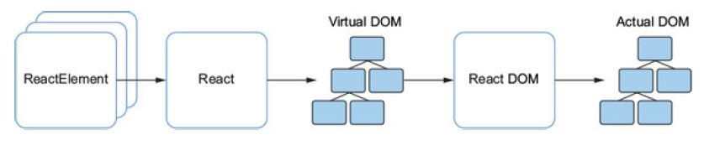
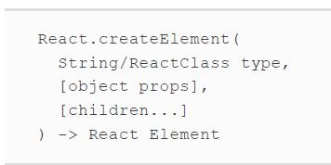
React elements are being used in the overall process of a React application.
React elements are what React uses to create a virtual DOM that React DOM will manage and use to reconcile and update the actual DOM.

Slide 29
React.createElement takes a string or component (either a class extending React.Component or a function),
a props object, and children and returns a React element.
Remember, a React element is a lightweight representation of something you want React to render.
It can indicate either a DOM element or another React component.
type— You can pass in either a string that is the tag name of the HTML element to be created ("div", "span", "a", and so on) or a React class.
What type of thing am I going to be creating?
props— Short for properties. The props object provides a way of specifying which attributes will be defined on the HTML element.

Slide 30
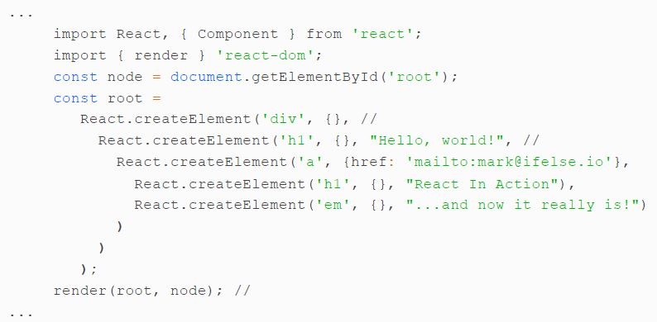
children...— Remember how I said React components are composable?
React.createElement asks, “What am I creating?”, “How should I configure it?”, and “What does it contain?”.

Slide 31
1 Import React and React DOM for use.
2 React.createElement returns a single React element, so that’s what you’ll store in root for later use.
3 Whitespace shows the nesting better, but don’t miss how you’re nesting several React.createElement calls within respective children... parameters.
4 Creating an anchor link—note the mailto property you’ve set, like how you might in regular HTML.
5 Inner text can also be passed in children....
6 Call the render method we talked about earlier.
you may be wondering how React turns your many React.createElements into what you see on the screen.
React uses the React elements you provide to create a virtual DOM that React DOM can use as it manages the browser DOM.

Slide 32
React needs to form its own virtual DOM tree structure from your React elements before it can do its work.
React will recursively evaluate a series of React elements to determine how it should form a virtual DOM tree structure for your components.
It will also check for more React elements in children... to evaluate.

Slide 33
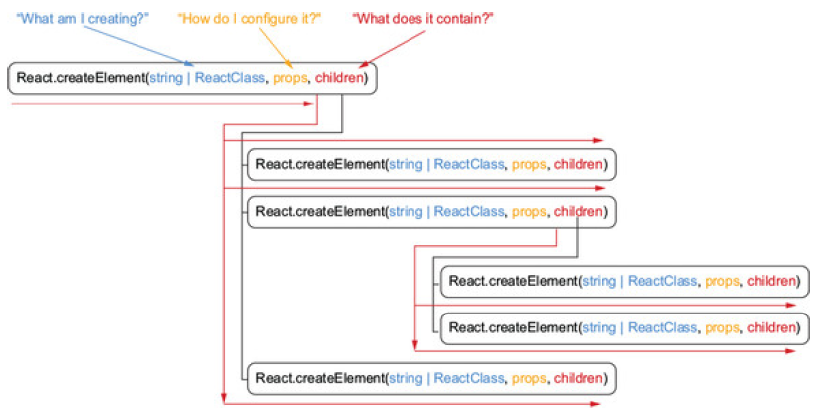

Slide 34
Now that you’ve created your first component, you may have a few questions and even some concerns.
Even with some formatting help, it’s clear that it will be difficult to read through components that are nested even a few levels deep.
Before moving on to components, check your understanding of React elements.
Either on paper or in your mind, list out a few of the characteristics of a React element
React elements take a string to create a type of DOM element (div, a, p, and so on).
You can provide configuration to the React element via a props object; these are analogous to attributes DOM elements can have (<img src="aUrl"/>, for example).

Slide 35
React elements are nestable and you can provide other React elements as the children of an element.
React uses React elements to create a virtual DOM that React DOM can use as it updates the browser DOM.
React elements are what components are made from in React.

Slide 36
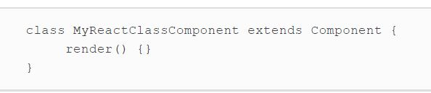
Creating React classes
To start really building something, you need more than just React elements;
you need components. As mentioned, React components (components created from functions) are like React elements but with more features.
They can be created as classes that extend the React. Component base class or functions.
Rather than invoke a specific method from the React library as you did with React.createElement,

Slide 37
creating a component from React. Component is done by declaring a JavaScript class that inherits from the React. Component abstract base class.
That inheriting class will typically need to define at least a render method that will return a single React element or an array of React elements.

Slide 38
The render method
This is one of the most common methods you’ll see in React applications, and almost any component that renders something to a screen will have a render method.
The render method needs to return exactly one React element. In this way, the render method is similar to how React elements are created.
they can be nested but at the topmost level there’s a single node.
the render methods of React classes have access to embedded data (persisted internal component state) as well as component methods and additional methods inherited from the React. Component abstract base class.
When using a React class to create a component, you also have access to props—data that you can pass to your component and that it can in turn pass to child components.

Slide 39
Property validation via Prop-Types
You know that React class components are free to use custom properties, and this sounds great.
you can use validators available from a namespace within React: PropTypes.
The PropTypes set of validators used to be included with the React core library,
To use PropTypes, you’ll need to install the prop-types package, which is still part of the React tool-chain but is no longer included in the core library.
This package will be included in the application source code and the CodeSandbox examples that you’ve been using in this chapter.
The proptypes library provides a set of validators that will let you specify what props your component needs or expects.

Slide 40
if you were going to build a Profile-Picture component, it wouldn’t be of much use without a picture.
You could use Prop-Types to specify which props your Profile Picture component would need to work and what those props would look like.
you need to add a prop-Types property to the React.Component class via a static class property or by simple property assignment after the class definition.
Note the lowercasing of the property on the class but not the one from the React object, as it can be easy to mix them up.
can use Prop-Types, as well as return React elements from React class components.
https://codesandbox.io/s/3yj462omrq

Slide 41
1 Import React, React DOM, and prop-types.
2 Create a React class as your Post component. In this case, you’re only specifying prop-Types and a render method.
3 Create a div element that has a class ‘post’.
4 What this refers to can sometimes be confusing in JavaScript—here it will refer to the component instance, not your React class blueprint.
5 Using className instead of class for the Dom element’s CSS class name
6 Again, the content prop is the inner content of a span element you’re creating.
7 Properties can be optional or required, have a type, and can even be required to have a certain “shape” (an object with certain properties, for example).
8 Pass the Post React Class to React.createElement along with ome props to create something. React DOM can render—try changing the data to see how the render for your component output changes.

Slide 42
If you hadn’t provided any of the required props, you’d see a warning in the developer console.
In other words, if you forget to provide a crucial piece of data to your application, it might break but using Prop-Types validation won’t it’ll just let you know that you forgot the prop.
Now that you’re creating a component and passing in some data, you can try nesting components.
https://codesandbox.io/s/k2vn448pn3
Now that you’ve created a nested component, you should be able to see more in your browser.

Slide 43
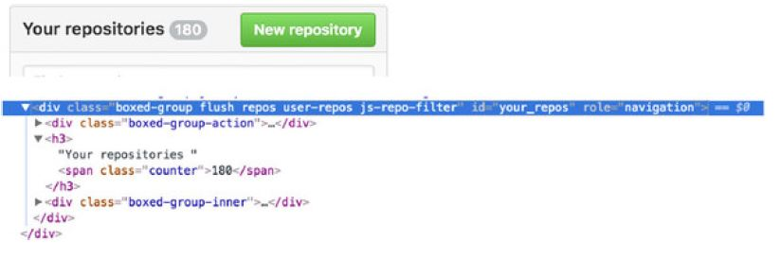
Reverse engineering a component tree
Open your developer tools, pick a DOM element that’s not too deeply nested, and reconstruct a React class from it.

Slide 44
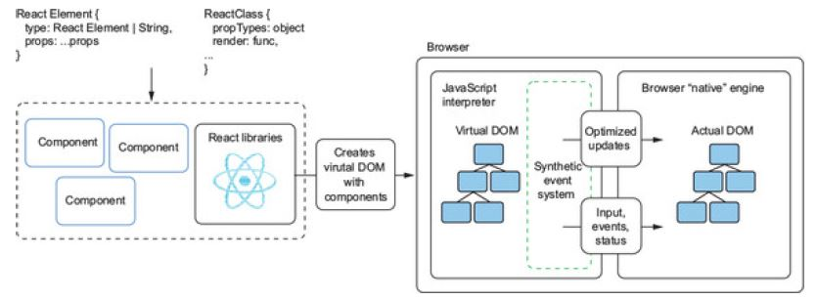
THE LIFE AND TIMES OF A COMPONENT
In this section, you’re going to add to your Post and Comment components to make them interactive.
Earlier, we discovered that components created as React classes get some special ways to store and access data through “backing instances.

Slide 45
Components created from React classes have backing instances that let you store data and need to have a render method that returns exactly one React element.
React will take React elements and create an in-memory virtual DOM from them, and it will handle managing and updating the DOM.
You’ve added a render method and some Prop-Types validation to your React classes.
you’re going to need more than that to create dynamic components.
React classes can have some special methods that will be called in a certain order as React manages the virtual DOM. render, which you’ve used to return React elements, is just one of those methods.
you can add your own methods. React gives you the freedom and flexibility to add whatever functionality you need to your components.

Slide 46
A React state of mind
Along with custom methods and lifecycle methods, React classes also gives you state(data) that can persist with the component.
In React, components created as JavaScript classes that extend React. Component may have both mutable and immutable state.
Where as components created from functions (stateless functional components) only have access to immutable state (props).
In these sorts of components, state is accessible from the this.state property of the instance of the class.
The immutable state made available to you is accessed with this.props, which you’ve been using already to create static components.
this.props shouldn’t be modified from within the component.

Slide 47
You may be wondering how you might use state and props in React. The answer is pretty much how you would use data passed to or used in a function. That includes calculations, display, parsing, business logic, and any other data related tasks.
In fact, props and state are the primary ways that you can utilize dynamic or static data in your UI (showing user information, passing data to event handlers, and so forth).
State and props are vehicles for the data that make up your app and make it useful.
If you’re using React for data visualization, you might use props and state as inputs for visualization libraries like D3.js.

Slide 48
Mutable vs. immutable
Mutable means that data can change over time: T | F
State is accessed with the this.state property in React: T | F
props is a mutable object provided by React: T | F
Immutable data doesn’t change over time: T | F
Props are accessed via this.props: T | F
----Setting Initial Stage—
You can use the constructor of the component to set the initial state for your component, a comment box component that builds on the ideas and concepts from earlier code listings.
https://codesandbox.io/s/p5r3kwqx5q.

Slide 49
1 Call super in the class constructor and assign the initial state object to the instance of the class’s state property—note that you won’t normally assign state like this except in the constructor of the component class.
2 Create a component as a React class that will have some input fields for the user—I’ll cover forms in more detail in future chapters.
3 Add Create Comment to the App component.
To update the state that you initialized in the component class’s constructor, you need to use a special method.
you can’t just overwrite this.state like you might in a nonReact situation.
That’s because React needs to keep track of state and ensure that the virtual DOM and real DOM are kept in sync.

Slide 50
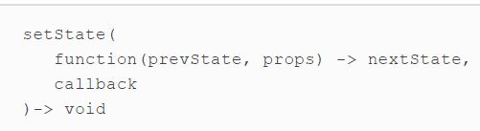
To update state within a React class component, you’ll use this.setState.
this.setState takes an updater function that returns object that will get shallowly merged into state.
React will take that value and update the backing instance and DOM with your new value.
React can choose to batch updates based on state changes to maximize efficiency.
This means that when you call setState to perform a state update, it won’t necessarily happen right away.
React will update the DOM based on new state in the most efficient way possible, as soon as possible.

Slide 51
How do events work with React?
React implements a synthetic event system as a part of the virtual DOM that will translate events in the browser into events for your React application.
You can set up event handlers that can respond to events from the browser, as you normally would in JavaScript.
One difference is that React event handlers are set up on React elements or components themselves (as opposed to using addEventListener).
You can update the state of your component using the data from these events.
https://codesandbox.io/s/x9mxo31pxp.

Slide 52
Because components created with classes don’t auto bind component methods, you need to bind them to this in the constructor.
2 Assign an event handler to handle changes to the author field—you get the value of the input element with event.target.value and use this.setState to update the component’s state.
3 Create an event handler with similar functionality for the comment content.
4 Event handler for form submission event
5 Reset the input field after submission so the user can submit further comments.

Slide 53
Did you notice how you used .bind in the constructor of the component class?
previous versions of React, React would auto bind methods to the instance of your component for you With the switch to JavaScript classes
Now that you have a way of listening for events and modifying the component’s state.
you can implement a way to create new comments using unidirectional data flow.
React, data flows top-down, as an input from parents to children.
When you create composite components, you can pass information to child components via props and make use of it in child components.
That means you could store the data from the Create Comment component in a parent component and from there pass the data to child components.
But how can you get the data from a new comment in a child component back into the parent and into the child.

Slide 54
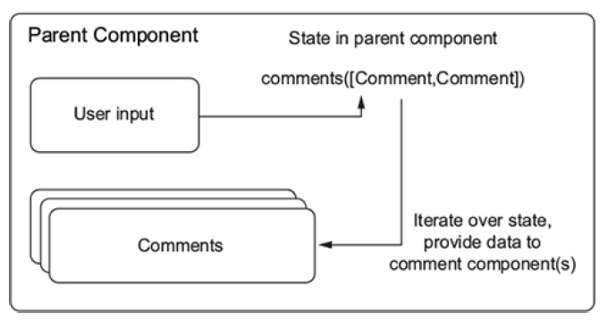

Slide 55
Functions can be passed as arguments to other functions in JavaScript, you can use this to your advantage.
You can define a method on a parent component and give it to the child component as a property.
That way, the child component can send data back up to its parent without having to know how the parent will handle the data.
If you needed to change what happened with the data, you wouldn’t need to do anything to the CreateComment component.
To execute a function passed as a prop, the child only needs to call the method and pass any data to it.
https://codesandbox.io/s/p3mk26v3lx

Slide 56
1 Call the onCommentSubmit function that’s been passed as a prop by the parent—you’re passing in data from the form and resetting the form so the user knows their action was successful.
2 Don’t forget to bind the method you’ve set up to the onSubmit event— without it, there won’t be any connection between the right event and your method.
Now that your component can pass new comment data to a parent, you’ll need to include some mock data so you can get started commenting.
using some fake data you create will be fine for now. The following listing shows how you might go about mocking out some basic post data with associated comments.

Slide 57
Next, you need a way to show all the comments. In React, that’s easy to do.
You already have a component that will display a comment.
Because all you need to work with React components is regular JavaScript, you can use the .map() function to return a new array of React elements.
You can’t use .forEach() inline because it doesn’t return an array and would leave React.createElement() with nothing to use.
you need to define a method you can pass to the CreateComment component.
It needs to modify the list of comments in its state by receiving data from the child component.
Both the submission method and the state need to go in a new parent component: CommentBox.

Slide 58
https://codesandbox.io/s/z6o64oljn4
1 Pass in the comments data at the topmost level to CommentBox.
2 Never directly modify state—instead, make a copy.
3 As before, pass in the data variable at the topmost level to access the post data.
4 Map over the comments in this.state.comments and return a React element for each one.
5 Give the parent’s handleCommentSubmit method to the CreateComment component to use.
6 Pass in the mock data to the CommentBox component as a prop.

Slide 59
MEET JSX
You’ve created your first dynamic React component. If you found it easy, great!
If you found parts of the code hard to read through with all the nested React.createElements, that’s fine, too.
We’re about to discuss some easier ways to create components, but needed to focus on the fundamentals first.

Slide 60
Creating components using JSX
What is JSX? JSX is an extension of JavaScript that’s similar to XML and is only intended for use by code transformation tools.
JSX helps by allowing you to write XML-style, In other words, it lets you write code that looks like HTML but isn’t.
now, look at what your comment box component might look like with JSX. I’ve omitted some code to make it easier to focus on the JSX syntax.
Note that Babel is included as part of the environment on CodeSandbox.
Normally, you’ll use a build tool like Webpack to transpile your JavaScript, but you can also import Babel and have it work without a build step.
You can learn more at https://babeljs.io.

Slide 61
https://codesandbox.io/s/vnwz6y28x5
1 Instead of creating props on an object, in JSX you create them like you would in HTML—to pass in expressions, you use the {} syntax.
2 This is the Post React class you created before—note now it’s much clearer that it’s a custom component you created and looks like it would belong right at home in HTML.
3 Use regular JavaScript inside of {} to iterate over comments and create a comment component for each.
4 Pass in the handleCommentSubmit handler as a property.
5 At the top level, CommentBox is also a custom component you give props to and pass to React DOM to render.

Slide 62
Benefits of JSX and differences from HTML
Similarity to HTML and simpler syntax— If writing React.createElement repeatedly felt tedious or if you found the nesting hard to follow, you’re not alone. JSX’s similarity to HTML makes declaring your component’s structure in a familiar way much easier and dramatically improves readability.
Declarative and encapsulated— By including the code that will make up your view alongside any related methods, you create a group of functionality.
Essentially everything you need to know about the component is in one place
It’s important to note that JSX is not HTML (or XML)—it will only transpile into regular React code just like you’ve used so far, and it doesn’t share the exact same syntax and conventions.

Slide 63
HTML tags versus React components— Custom React components you created using React.createClass are by convention capitalized so you can determine the difference between custom and native HTML components.
Attribute expressions— When you want to use a JavaScript expression as an attribute value, wrap the expression in a pair of curly braces (<Comment a= {this.props.b}/>) instead of quotes (<Usera="this.props.b"/>).
Boolean attributes— Omitting the value of an attribute (<Plan active/>,<Input checked/>) causes JSX to treat it as true. To pass a false value, you have to use an attribute expression (attribute={false}).
Nested expressions— To insert the value of an expression inside an element, you also use a pair of curly braces (<p>{this.props.content}</p>).

Slide 64
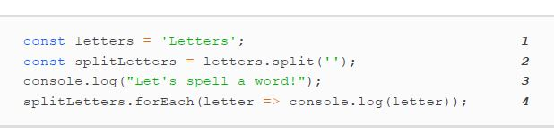
What is state?
Let’s take a brief and simplified look at state so you can have a better understanding of it when we look at state in React.
For example, this might include any variables you previously created or other available values.
When you change a variable you change the state of a program, and it’s no longer the same as it was before.
You can retrieve state by getting values, but when you change something over time, the state of a program has changed.
Let’s look at some code

Slide 65
1 Store a string in a variable called letters.
2 Split the letters into an array of strings.
3 Print out a message.
4 Print out each letter.
simple script that does some basic assignment and manipulation of data and logs it out.
that programs will be executed from top to bottom,
letters is a variable with a string “Letters” assigned to it.
the state changed over time, and more information became available because you haven’t deleted anything or changed references.

Slide 66
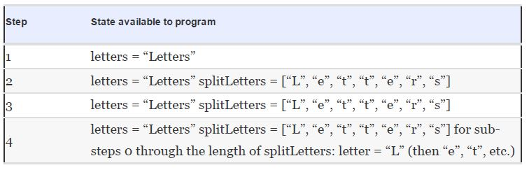
Mutable and immutable state
In React applications, there are two primary ways that you can work with state in components.
In React components, state is generally mutable, and props shouldn’t be changed.
That when we call state mutable we mean we can overwrite or update that data.
Immutable state, on the other hand, can’t be changed.
You can access state in your components that inherit from React.Component via this.state.

Slide 67
In this case, this refers to the instance of the class, and state is the special property that React will keep track of for you.
You can access state in your components that inherit from React.Component via this.state. In this case, this refers to the instance of the class, and state is the special property that React will keep track of for you.
https://codesandbox.io/s/ovxpmn340y.

Slide 68
1 Create a React component that will have access to persistent component state over time—don’t forget to bind your class methods to the component instance.
2 Provide an initial state for the component so that attempts to access it in render() don’t return undefined values or throw errors.
3 Our first look at setState, the special API for modifying component state; call setState with a callback function that returns a new state object for React to use.
4 Bind the name revealing function to the click event emitted by the button.
5 Render top-level components to an HTML element at the topmost level of an application—identify your container however you like, as long as ReactDOM can find it.

Slide 69
creates a simple component that will reveal a secret name when you click a button using setState to update the component state. Notice that setState is available on this because the component inherits from the React.Component class.
When you click the button, a click event will be fired function you’ve told React to respond with will be executed.
When it’s executed, it will call the setState method with an object as a parameter.
That object has a property, name, that points to a string. React will schedule an update to state.
When this work has occurred, React DOM will update the DOM if necessary.
Your render function will be called again, but this time with a different value available to the JSX expression syntax ({}) that contains this.state.name.

Slide 70
setState is a straightforward API to use; you give your ReactClass component some data to merge into the current state, and React will handle it for you.
https://codesandbox.io/s/0myo6ny4ww.
1 name exists in the initial state under the user property...
2 ...but not in the state you’re setting—if it had been a level up, a shallow merge wouldn’t have worked.

Slide 71
Working with props: Prop-Types and default props
When working with props, you have a few APIs available to you that can help you during development.
PropTypes and default props.
PropTypes provides a type-checking functionality in which you can specify what sort of props your component will expect to receive when used.
The prop-types library isn’t magic—it’s a set of functions and properties that can help do type-checking on inputs.
you provide a static property on the class called prop-Types. that the name of the static property you set on a component class is lowercase, whereas the name of the object you access from the prop-types library is uppercase.
You can provide a static property called default-Props to provide default props to your component.
https://codesandbox.io/s/31ml5pmk4m
1 Specify an object with a “shape.”
2 You can chain any prop-Types with isRequired to make sure a warning is shown if the prop isn’t shown.

Slide 72
Stateless functional components
What do you do if you want to create a simple component that only uses props and no state?.
you often want to keep state in a centralized location and not distributed across your components.
But only using props is also useful in other situations.
Rendering and lifecycle methods in React
you’re going to start building the application Letters Social.
we’re a startup focusing on creating the next great social networking application.
Creating posts that have text
Adding locations to posts with Mapbox
Liking and commenting on posts
Providing OAuth authentication via GitHub and Firebase
Displaying posts in a newsfeed
Using basic pagination

Slide 73
Introducing lifecycle methods
Lifecycle methods are special methods attached to class based React components. That will be executed at specific points in a component’s lifecycle.
A lifecycle is a way of thinking about a component.
Lifecycle methods aren’t unique to React; many UI technologies employ them due to their intuitive and useful nature.
They’re only available to components that are created from classes that extend the React.Component abstract base class.
Lifecycle methods can be broken into two main groups.
Will methods— Called right before something happens
Did methods— Called right after something happens
There are also a few other methods that don’t fit into either of these groups. They’re related to initialization and error handling, and one is for updating.
We can further break them down into several more types based on what part of the lifecycle they’re related to.

Slide 74
Types of lifecycle methods
Components have four main parts of their lifecycle and corresponding lifecycle methods for each.
Initialization— When a component class is being instantiated.
Mounting— A component is being inserted into the DOM.
Updating— A component is being updated with new data via state or props.
Unmounting— A component is being removed from the DOM.
There are lifecycle methods that will be called during initialization as well as before and after component mounting, updating, and unmounting.
There aren’t that many of these methods, especially when compared to other libraries and frameworks.
Refer page no 101 for more info.

Slide 75
But these specific lifecycle methods are unique to React.
To explore these methods, you’ll create two simple components—a parent and child—that will implement all the lifecycle methods we’ll look at.
https://codesandbox.io/s/2vxn9251xy
1 Declare a child component.
2 Set up propTypes as a static method on the class.
3 Set default props—normally you’d set this as an object and not a function, but you’re using an immediately executing function to inject the console.log statement.
4 Create a parent component.
5 Bind the onInputChange method in the constructor so you can reference the method within render and have it point to the class instance, not definition.
6 Update state with the data from the form input.
7 Render the child component within the parent.
8 Use React DOM to render the parent component.

Slide 76
Initial and “will” methods
These include two properties you’ve already learned about: defaultProps and state (initial).
These properties help provide initial data to your component.
defaultProps—A static property that provides the default props for a component.
Sets on this.props if that prop is not set by the parent component, is accessed before any components are mounted,
and can’t rely on this.props. Or this.state. Because defaultProps is a static property, it’s accessed from the class, not instances.
state (initial)—The value of this property in the constructor will be the initial value set for the state of your component.
That’s especially helpful when you need to provide placeholder content, set default values.

Slide 77
It’s similar to default props with the exception that the data is expected to be mutated and only available on components that inherit from React.Component.
Even though setting initial state and props isn’t done with special methods from the React Component class.
they’re still part of the component lifecycle.
It’s easy to accidentally exclude them in your mind, but they play an important role in providing data for your components.
You’ll create a parent component and a child component so you can see not only the order in which different methods are called, but also how that order is worked out between parents and children.
To keep things simple, you’ll only be logging information out to the developer console.
https://codesandbox.io/s/2vxn9251xy.

Slide 78
Mounting components
Now that you’ve created your parent and child components, let’s look at mounting.
Mounting is the process of React inserting a component into the DOM.
components only exist in the virtual DOM until React creates them in the real DOM.
for an overview of mounting and the rendering process for the parent and child components.
Mounting methods will let you “hook” into the beginning and end of a component’s life and are only fired once because, by definition, there can only be one beginning and end to a component.

Slide 79
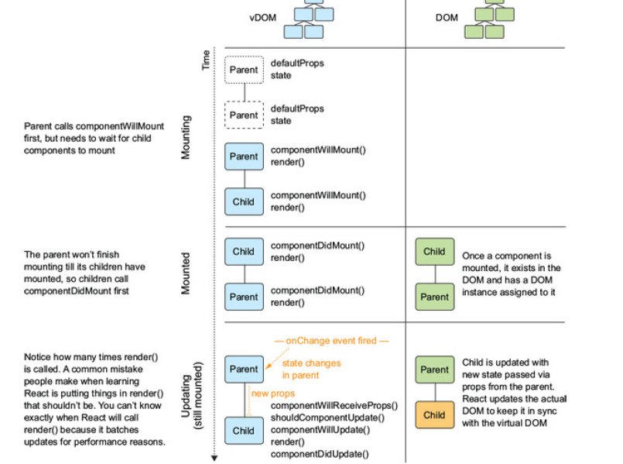

Slide 80
Mounting is the process of React inserting your components into the real DOM.
Once done, your component is “ready,” and it’s often a good time to do things like perform HTTP calls or read cookies.
At this point you’ll also be able to access the DOM element via something called a ref, discussed in future chapters.
you’ll notice that you only have one opportunity to change state before a component is mounted.
You can do that by using componentWillMount, which will provide the opportunity to set state or perform other actions before your component mounts.
Any changes to state within this method won’t trigger a re-render, unlike other updates to state that will trigger the update process seen earlier.
It’s important to know which methods trigger a rerender and which don’t so you can understand how your app will behave as well as debug it if something goes wrong.
Mounting methods in the context of the larger lifecycle process.

Slide 81
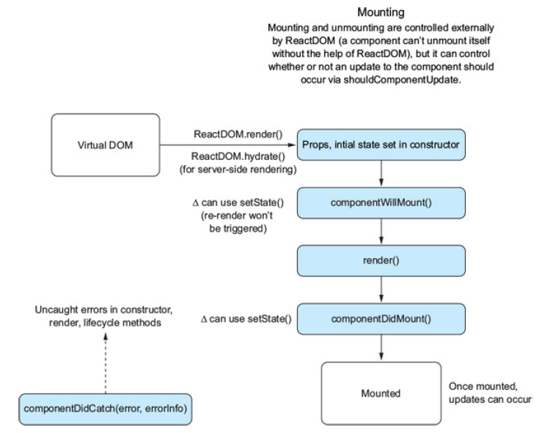

Slide 82
The next method I’ll cover is componentDidMount. When React calls this method, you have the opportunity to use componentDidMount as well as access refs on components.
In this method, you have access to component state and props as well as the knowledge that your component is ready for updates.
That means it’s a good place to do things like update your component state with data coming back from a network request.
It’s also a great place to work with third-party libraries that depend on the DOM, like jQuery and others.
If you execute handlers or other functions in other methods (like render()), you’ll end up with unpredictable and unexpected results due to how React works.
Now that we’ve looked at some of the methods related to mounting, you’ll add them to your components so we can see the component lifecycle.

Slide 83
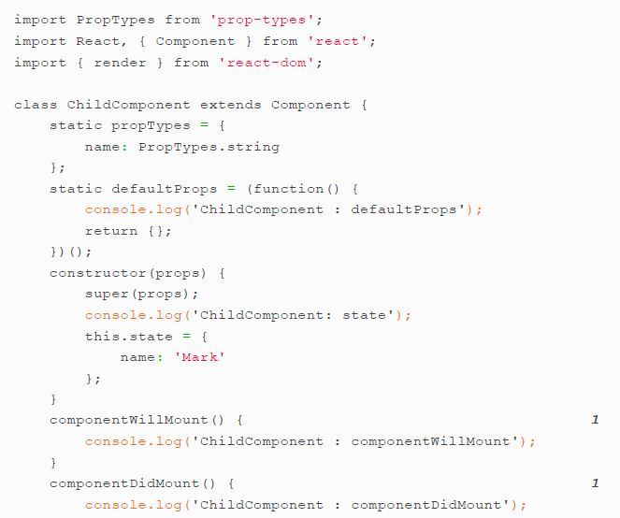

Slide 84
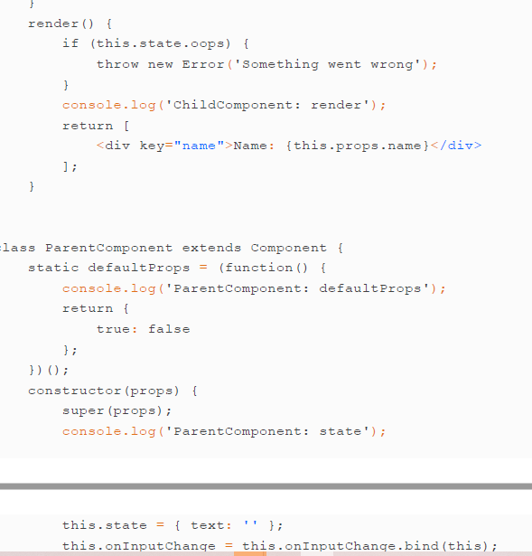

Slide 85
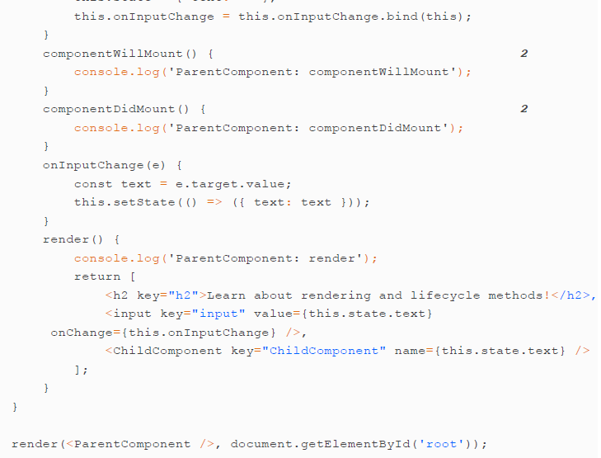

Slide 86
1 Add componentDidMount and componentWillMount to the child component.
2 Add componentDidMount and componentWillMount to the parent component.
Updating methods
Once your component is mounted and in the DOM, you’ll want to update it.
In chapter 3, you saw that you can use this.setState() to perform a shallow merge of new data into the component state, but more than that goes on when you trigger an update.
React provides several methods you can use to hook into the update process.
shouldComponentUpdate, componentWillUpdate, and componentDidUpdate
Updating lifecycle methods. When a component is being updated, several hooks fire that let you determine whether the component should be updated at all, how to update, and when the update is done.

Slide 87
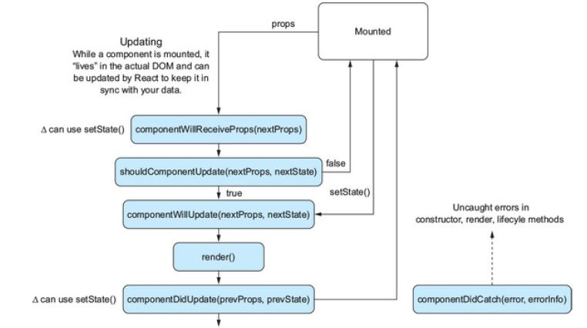

Slide 88
Unlike with other methods we’ve seen so far, you’re given the option to control whether an update should occur.
Another difference between the “update” methods and those related to mounting is that they provide arguments for props and state.
You can use these to determine whether an update should occur or to react to changes.
If shouldComponentUpdate returns false for some reason, render() is skipped until the.
This means you can prevent your component from unnecessarily updating next state change.
Because the component won’t update, the next methods, componentWillUpdate and componentDidUpdate, won’t be called.

Slide 89
Unless you specify otherwise, shouldComponentUpdate will always return true, but if you’re careful to always treat state as immutable and to read only from props and state in render(), then you can override shouldComponentUpdate with an implementation that compares the old props and state to their replacements.
That can be useful for performance tuning but should be treated as an escape hatch

Slide 90
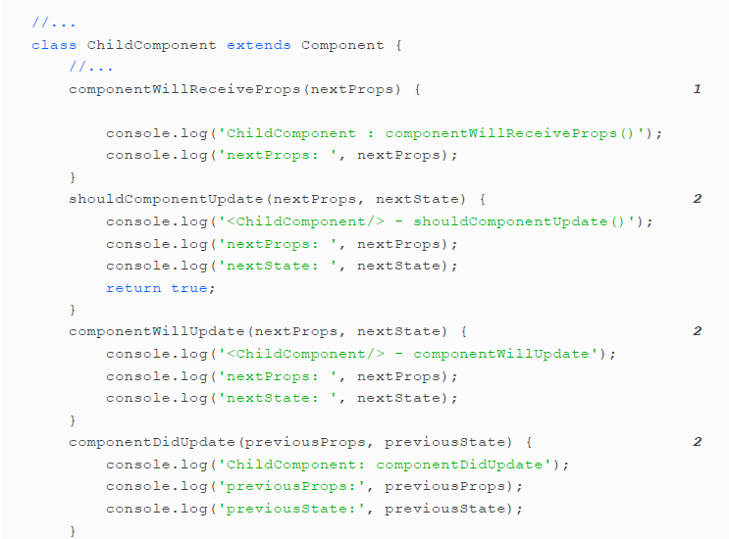

Slide 91
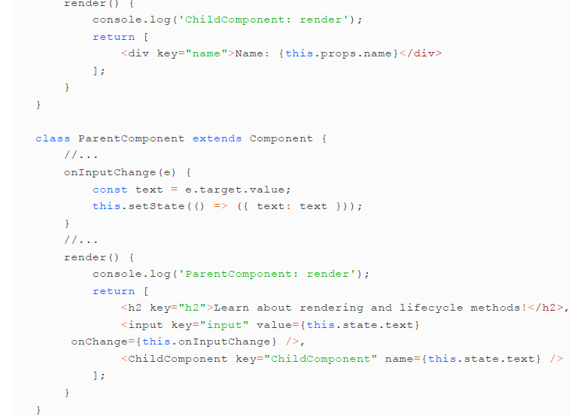

Slide 92
1 Add update methods to the child component so you can inspect the update process on a single component.
Now that you’ve specified update methods for your components, try running them again and type something into the text box.
You’ll see a cascading output in the developer console.
Take a minute to look at the order of rendering.
Notice anything? The order should cohere with what you’ve learned so far in this chapter, but now you get to see how child and parent component ordering matters.
children have to be created before the parent component’s mounting can be considered complete. If the child didn’t yet exist, the parent couldn’t be said to be mounted.
You’ll also note that when an update occurs, you’ll see the child component receive props because the prop of that child has been changed by the parent via this.setState().

Slide 93
Unmounting methods
Unmounting is the process of removing a component from the DOM.
Regardless of what it is, you can take advantage of componentWillUnmount to do any cleanup you need to when a component is being removed.
React DOM is responsible for mounting and unmounting components
Mounting is the process of inserting your components into the DOM and unmounting is the opposite: the process of removing your components from the DOM. Once components are unmounted, they no longer exist in the DOM.

Slide 94
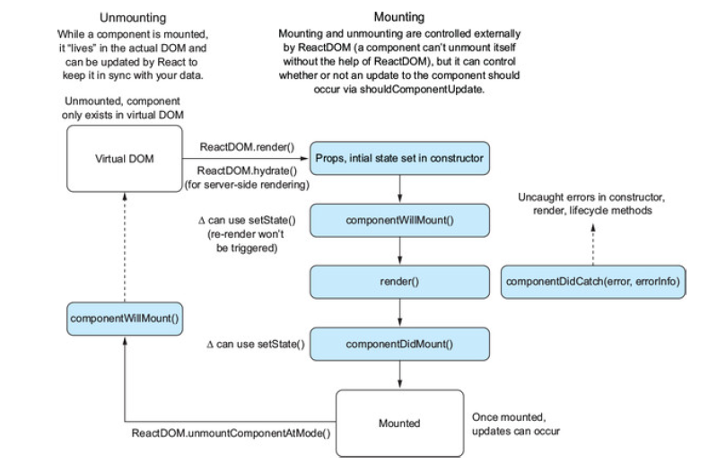

Slide 95
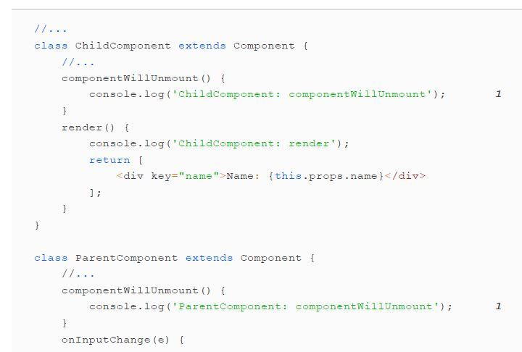
Let’s add the componentWillUnmount to our running example so we can get the full picture of a component’s lifecycle.

Slide 96
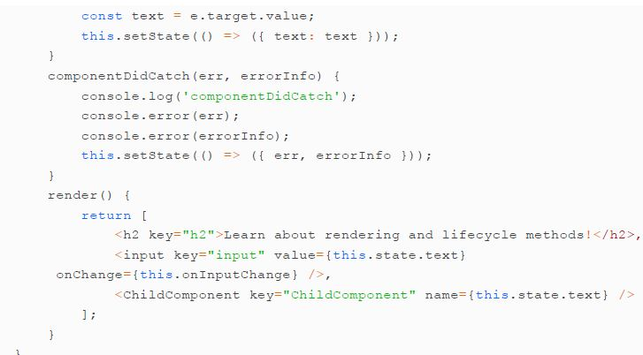
Catching errors
Error handling is a firstclass part of writing clean programs. So far, we haven’t seen any special methods in React for dealing with errors.

Slide 97
React introduced a new concept called error boundaries to help deal with this. If an uncaught exception is thrown within a component’s constructor, render, or lifecycle methods, React will unmount the component and its children from the DOM.
You can handle these errors by using another method that your components inherit from React.Component: componentDidCatch.
The semantics of the method are similar to the try...catch behavior you’d see in JavaScript.
componentDidCatch gives you access to the error being thrown and an error message.
The following listing shows how to add the componentDidCatch method to the parent component.

Slide 98
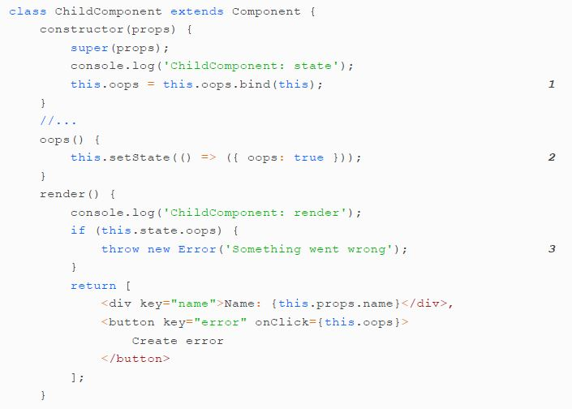

Slide 99
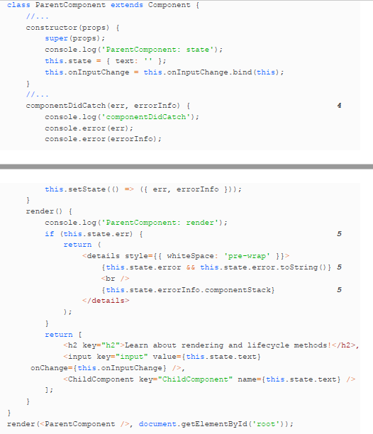

Slide 100
1 Bind the class method.
2 Toggle state so you throw an error.
3 Throw an error in the render method.
4 Add a componentDidCatch method to the parent and use it to update component state.
5 If an error is thrown, display the error and error message.

Slide 101
GETTING SET UP WITH THE LETTERS SOCIAL REPO
If you don’t have one of these versions of node on your computer, head to https://nodejs.org to download a copy of the latest stable version of node.
Different versions of node support different features of JavaScript, so it’s important to know what the version you’re using supports.
You can also read some basic documentation about the files in the source code at https://docs.react.sh. It’s not comprehensive, but if you’d like to get a sense of the code.
To get the source code, go to https://github.com/react-in-action/letter-ssocial. This is the repository where all the source code related to the book is stored.
either download the source or use the following command to clone the repository.
git clone git@github.com:reactinaction/letters-social.git
git checkout chapter4.
The next step is to install dependencies. We’ll use npm

Slide 102
(www.npmjs.com) in this book for the sake of consistency.
All the modules you’ll need for the entire book should be included in package.json in the application source.
npm install
That will install all the dependencies you’ll need. If you change versions of node you’ll need to reinstall your node modules because different versions of node will compile different modules differently (like node-sass).
npm stands for Node Package Manager. Packages are a fundamental part of the node ecosystem - they exist to allow you to use other people's solutions to common problems.
his can get very confusing, since, because this is an open source community, hey are all being released at different times by different people.
Also, two different packages that you use may actually be dependent on a third package that is completely unknown to you, and potentially they may even need different versions of that package.

Slide 103
npm helps you deal with these 'dependencies' in a way that is easier to manage and think about,
So when you start a new project, you type npm init and this tells npm to make a file in your folder called package.json that is going to help you organise these dependencies.
package.json will hold the information about your own app.
packages are meant to have unique names, which is why you should call your package something personal to you.
First you will make your project directory. This is just an empty new directory. Let's call it npm-ts.
From inside the ts directory, type npm init into your terminal and answer its questions.
Then look inside the directory and you will see the package.json file. Open the file, and you will see all your package information. And currently that's it.
So now back to the command line and type npm install time-stamp. When it's finished thinking open package.json again and you will see time-stamp referenced in the list of 'dependencies.'

Slide 104
Before version 5, NPM simply installed a package under node_modules by default. When you were trying to install dependencies for your app/module, you would need to first install them, and then add them (along with the appropriate version number) to the dependencies section of your package.json.
The --save option instructed NPM to include the package inside of the dependencies section of your package.json automatically, thus saving you an additional step.
In addition, there are the complementary options --save-dev and --save-optional which save the package under devDependencies and optionalDependencies, respectively.

Slide 105
The API server and database
To prevent you from having to run a database like MongoDB or PostgreSQL, we’ll use a simulated REST API via the JSON-server library.
To create sample data or reset your application data, you can run this command.
npm run db:seed
That will overwrite the existing JSON database and replace it with new sample data.
later, you’ll be able to create a user in the database after you log in.
If you rerun the database seed command, your user will get overwritten, and you’ll have to log out and log back in to get things fixed.
Running the app
The easiest way to get started running the app in development mode will be to run the.
npm run dev

Slide 106
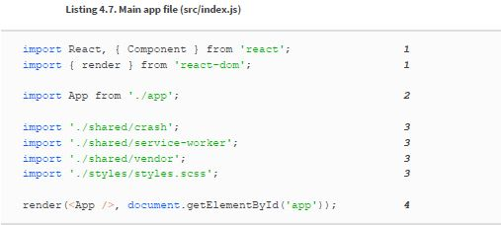
STARTING TO CREATE LETTERS SOCIAL
Now that you know a little bit more about React’s lifecycle methods and what they do,
let’s put those skills to use. You’re going to start building out the Letters Social application.

Slide 107
1 Import React and the render method from React DOM—this file will be where the main call to React DOM’s render method will be.
2 Import the default export from the App component—you’ll create this in the next listing.
3 Import some files related to error reporting, a service worker register, and styling (handled by repository setup).
4 Call render with the main app on a target element (the HTML template can be found in src/index.ejs).
The main app file contains references to some styling that Webpack can import as well as the main call to React DOM’s render method.
This is the main place your React app will “start.” When the script is executed by the browser, it will render the main app and React will take over.
Without this call, your app won’t be executed.
Now that you have an entry point for your app, let’s create the main App component.
You can place this file in the src directory as src/app.js.

Slide 108
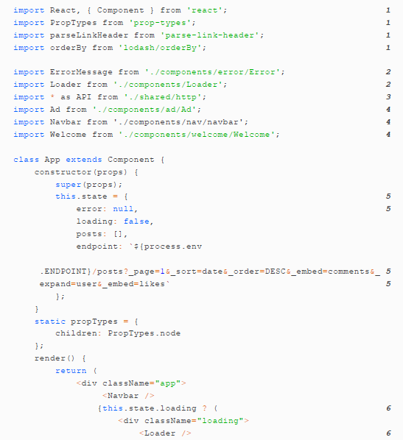

Slide 109
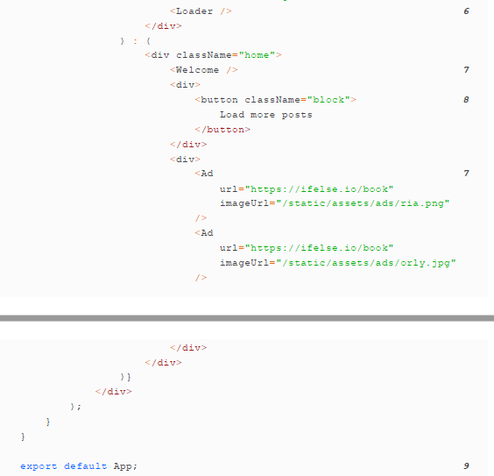

Slide 110
1 Import the libraries you’ll need for the App component.
2 Import the error message and loader components to use.
3 Import the Letters API module for use in creating and fetching posts.
4 Import the preexisting Ad, Welcome, and Navbar components.
5 Set up initial state for the component—you’ll keep track of posts and an endpoint to hit for more posts.
6 If loading, render a loader and not the app body.
7 Render the Welcome and Ad components.
8 This is where you’ll add components for displaying posts.
9 Export the App component.

Slide 111
With that, you can run the development command (npm run dev) and your app should at least boot up and be available in the browser.
If you haven’t already, make sure you run npm run db:seed at least once to generate sample data for your database.
Running npm run dev will do a few things for you:
Start up the Webpack build process and development server
Start the JSONserver API so you can respond to network requests.
When the app is up and running in development mode, you should be able to view the running app at http://localhost:3000. The API server is running at

Slide 112
Right now, your component doesn’t do much. You haven’t defined any lifecycle methods outside of the constructor and render methods.
so the component doesn’t have any data to work with.
You need to fetch data from the API and then update component state with that data.
You’ll also add an error boundary so that if your component encounters an error you can show an error message instead of the entire app unmounting.

Slide 113
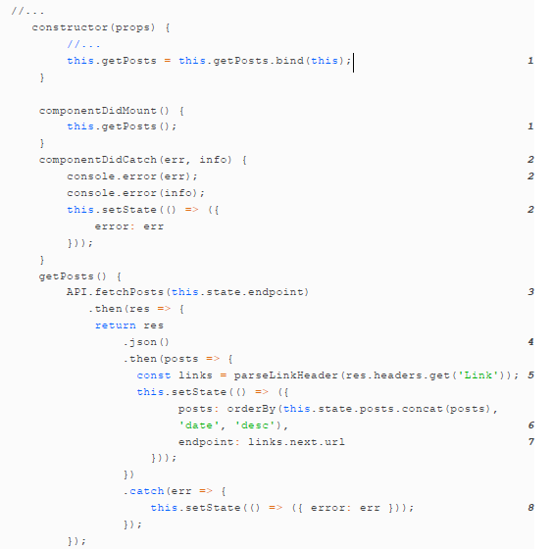

Slide 114
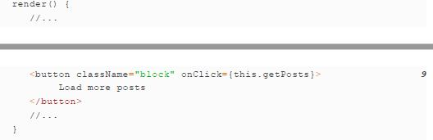
1 Bind class method and use it to fetch posts from the API when the component mounts.
2 Set up an error boundary for the app so you can handle errors.
3 Fetch posts using the included API module.
4 The API module uses the Fetch API, so you need to unwrap the JSON response.
5 The Letters Social API returns pagination information in headers, so you can use the parselinkheader to pull the URL for the next page of posts out.
6 Add the new posts to state and ensure they’re sorted correctly.
7 Update the endpoint state.

Slide 115
8 If there’s an error, update component state.
9 Now that you have it defined, assign the getPosts method to the load more event handler.

Slide 116
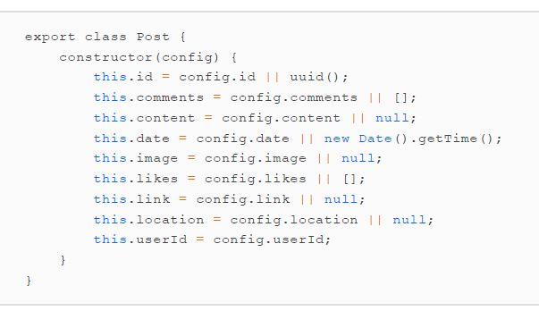
Working with forms in React
Now that you know a little about the data you’ll be able to work with you can start to think about how you might be able to express this data in component form.
There are plenty of examples of the sort of social networking app you’re creating.

Slide 117
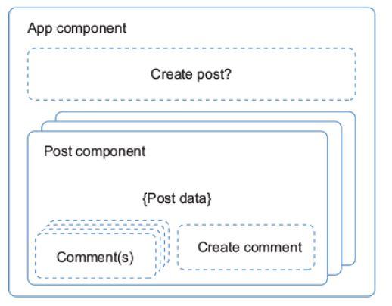
Let’s see how to create the skeleton for your component You’ll put in just the basics of a component that will render a basic element out, import the right tools.
export the Component class, and set up PropTypes to be defined later.

Slide 118
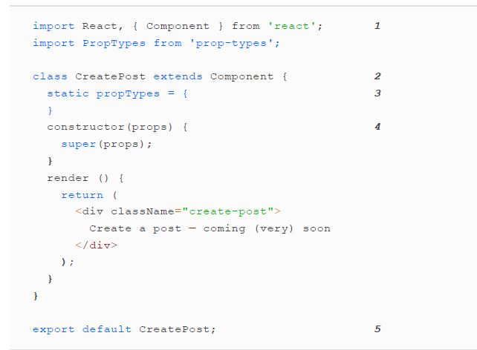
1 Import React and the PropTypes object so you can use it.
2 Create a React component.
3 Declare PropTypes as a static property on the class.

Slide 119
4 Set up the constructor—you’ll use this later.
5 Export the component so you can use it elsewhere.
FORMS IN REACT
Components have two main ways of working with data: state and props.
Because they’re JavaScript classes, components can have custom class methods in addition to lifecycle hooks that can be used to respond to events and for just about anything else.
As you might for regular DOM elements, you can listen for events like clicks, input changes, and other events in React components.
Parent components (such as form elements) can provide callback methods as props to child components, making it possible for components to communicate with each other.

Slide 120
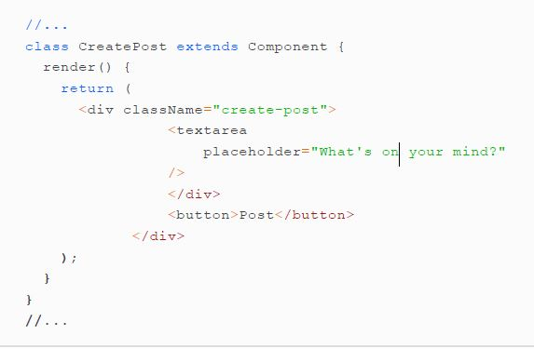
To create a post, you’ll need to make sure that the post is persisted to your database,
that you’ve created the barebones markup for your basic form.
It lets you listen for regular events like clicks, scrolls, and others and react.

Slide 121
You’ll take advantage of these events as you work with your forms.
Many different events can occur in the browser as a result of user interaction including mouse moves, keyboard typing, clicks, and more.
We’re concerned with a few of these types of events in particular when it comes to your app.
For our purposes, you want to listen with two main event handlers—onChange and onClick.
onChange— This is fired when an input element changes. You can access the new value of the form element using event.target.value.
onClick— This is fired when an element is clicked. You’ll listen for this so you can know when a user wants to send a post to the server.

Slide 122
For now, you’ll put in some console logging side effects for these functions so we can observe them being fired.
You’ll replace these with real functionality later,
The following listing shows how you can set up the event handlers by binding them in the component class constructor and then assigning them in the components.

Slide 123
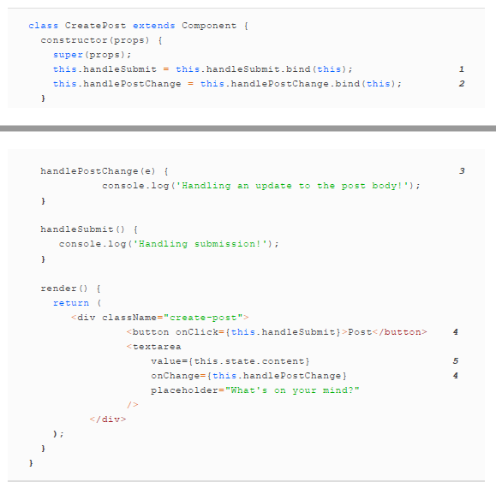

Slide 124
1 Bind class methods for handling submission and post changes.
2 Declare method on class to be used when update occurs to body text (the onChange event)
3 Declare method for handling submission event, and React will pass event to handler
4 Pass event handlers to the button and textarea components.
5 Value of component will be read from component state.
Event handlers receive a synthetic event as an argument and we have access to a number of available properties on the synthetic event.
Focus on line number 138 for events.

Slide 125
Before we move on, try something: add console.log(event) to the post component’s change event handler.
If you type something into the textarea element and open the developer console for your browser, you should see messages being logged.
If you inspect these objects or try accessing some of the properties in table 5.1, you should get back information about the event.
For our purposes, we’ll be concerned with the target property that you get back.
Remember, event.target is just a reference to the DOM element that dispatched the event, as it would be in normal JavaScript.

Slide 126
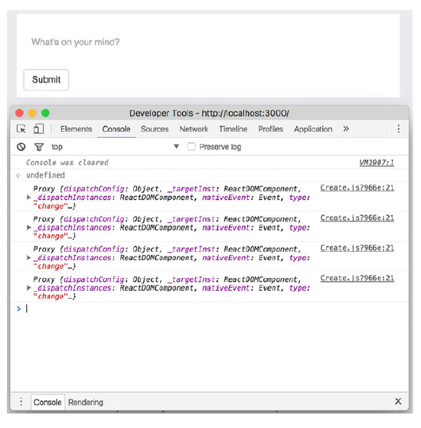

Slide 127
Updating state in forms
You need to do something with the events to update your application state.
State and props are the two main ways that React lets you work with data.
Right now, if you try to type something into the form, nothing happens.
That may seem like an error at first, but it’s just React doing its job.
Because you haven’t changed anything in the in-memory DOM.
React won’t update the actual DOM with any changes.
Let’s see how to put this into practice.
how to set up event handlers to listen to and update the state of your components when a user changes a data value.

Slide 128
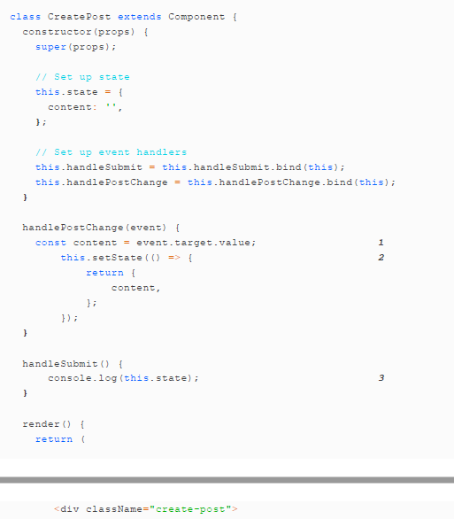

Slide 129
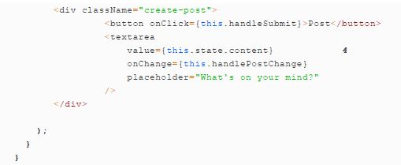
1 Grab value of textarea element from value property of DOM element (what you want to update state with)
2 Use that value to set state and update it with new value
3 To see updated state, hit form submission button and inspect developer console
4 New value for textarea element is provided to element

Slide 130
Controlled and uncontrolled components
This approach to updating component state in forms.
tightly controlling how updates occur by using events and event handlers to update state.
is probably the more common way to handle forms in React.
Components that are designed with this process in mind are generally known as controlled components.
That’s because we tightly control the component and how state is changed.
But there’s another way of designing components that use forms, known as uncontrolled components.

Slide 131
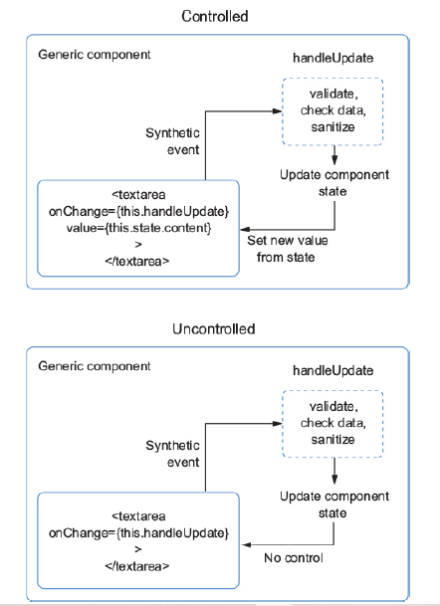

Slide 132
In an uncontrolled component, rather than use a value property to set data, the component maintains its own internal state.
You can still listen for updates to the input using an event handler.
but you’ll no longer manage the state of the input
shows an example of using an uncontrolled component approach
See the example in next page.
1 Your handlers are the same as before, but the effect that changing state has won’t be the same.
2 As noted, there’s now no value element that will listen to the component state.

Slide 133
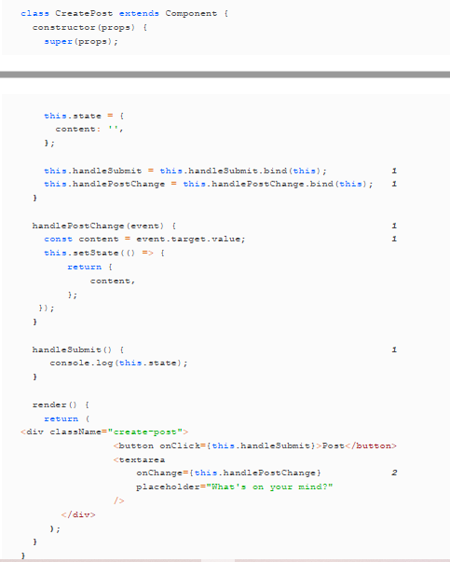

Slide 134
Form validation and sanitization
One important part of using forms to record and store user input is letting users know, when they’re violating any validation rules you’ve set up and when they’re doing anything to provide data that doesn’t satisfy your application.
Hopefully, the server applications that receive data from your client-side application will have strict data validation and sanitization procedures in place .
As we’ve seen so far, using forms to update component state involves state, props, and component methods, like much else in React.
To add validation and sanitization to your component, you need to hook into the update process.
To that end, you’ll be writing general purpose validation and sanitization functions that could be used anywhere you can use JavaScript and probably in most other frontend frameworks.
Fortunately, the CreatePost component you’re creating doesn’t require extensive validation.
You only need to check for a maximum length and do some additional validation so the component won’t submit empty posts to the API server.

Slide 135
We’re using a simple server setup for the purposes of learning and local development.
so it will accept most payloads without doing much validation.
Writing applications on the server is another domain outside the scope of this book.
so I’ll only focus on validation and sanitization on the browser.
You need to ask yourself a few questions when setting up validation for forms and inputs in your applications:
What are the data requirements for the application?
Based on these constraints, how can you help your users provide meaningful data?
Are there ways you can eliminate inconsistencies in data that users provide?

Slide 136
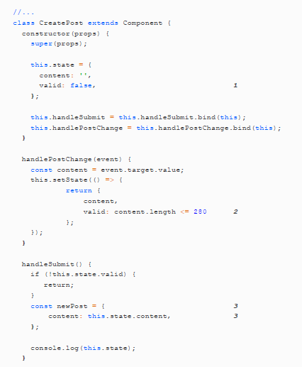

Slide 137
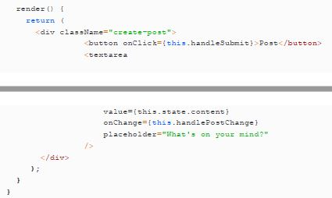
1 Create a simple valid property in local component state
2 Determine validity of post by setting max length here—280 demonstrates usage, but users sometimes want posts to be long
3 Create a new post object.
We’ve worked on answering the first two questions (data constraints and validation).
Now we can approach the final aspect: eliminating data inconsistencies with

Slide 138
CREATING NEW POSTS
Now that you’re performing some basic validation and sanitization of posts, you’ll want to create them by sending them to the server.
We’re going to introduce slightly greater complexity to achieve this, so we’ll go over each step briefly and then look at an illustration of what the process will look like all put together.
To send your post up to the API, you’ll need to do the following things
you’ll need to do the following to send the data up to your API.
1. Capture the user input to be used as the post, updating state and performing the data checking logic you’ve implemented so far.
2. Call an event handler function passed from the parent component (the main App component in this case) as a prop and give the post data to it.
3. Reset the CreatePost component’s state.
4. In the parent component, use the data passed from the CreatePost child component to perform an HTTP POST to the server.
5. Update the local component state with the new post you receive from the server.

Slide 139
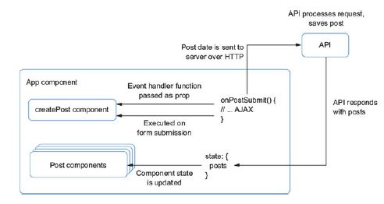
You’ll start by adding a function that will handle post submission in the parent component (App.js).
There are several parts to this function, so you’ll add them one at a time and we’ll go through each

Slide 140
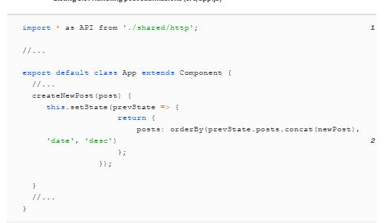
1 Import the Letters API module.
2 Concat the new post and make sure posts are sorted.
You’ve set up the postcreation handler function in the parent component, but it won’t do anything at this point because nothing ever calls it.
That’s because you need to give it to its child component
Remember how you can pass data from parent to child as props? You can pass functions, too.

Slide 141
That’s crucial because it allows components to cooperate and work together.
Even though components can interact, they’re not so intertwined or coupled that you could never move them around.
the CreatePost component could just as easily be moved to another part of the application and emit the same data to another handler.

Slide 142

Integrating third-party libraries with React
you created a comment box component that allowed you to add comments.
It persisted these locally, only in memory—the moment you refresh the page, any comments you added are gone because they live and die with the state of the page at a given time

Slide 143
1 Use the Letters API to create the post.
2 Get the JSON response.
3 Using the new post, update state.
4 Make sure posts are sorted using Lodash’s orderBy method.
5 Set the error state, if any.
With that, you only have one last thing to do: invoke the post creation method inside the child component.
The following listing shows how to call the method passed as a prop inside the child component.

Slide 144


Slide 145
1 Prevent default event and create an object to send to the parent component
2 Make sure you have a callback function to work with.
3 Invoke onSubmit callback passed via props from the parent component, passing in new post
4 Reset state to initial form so user has visual cue that post was submitted.
Now, if you run the application in development mode using npm run dev, you should be able to add posts!.
They should appear in your feed right away, but if you refresh your page, you should still be able to see your added post.

Slide 146

ENHANCING YOUR COMPONENT WITH MAPS
Now that you’ve added the ability to create posts to your app and send them to the server, you can move on to enhancing it a bit

Slide 147
that you’re going to use Mapbox to create your maps.
Mapbox is a mapping and geoservices platform that provides an incredible variety of map and location-related services, do geographic search, add navigation, and more
You’ll need a way to display a location to the user both when they’re picking a location for a new post and when a post renders in their newsfeed.
We’re going to see how to create a component that will serve both purposes so you can reuse your code.
You may not always be able to do this because each place where a map is needed may have different demands.
But for this case, sharing the same component will work and will save you extra effort.
Start by creating a new file called src/components/map/DisplayMap.js. You’ll put both our maprelated components in this directory.
Where’s the Mapbox library coming from? In most other cases, we’ve used libraries that we installed from npm.

Slide 148
If you look in the HTML template included with the source code (src/index.ejs), you’ll see a reference to the Mapbox JS library (mapbox.js):
<script src=https://api.mapbox.com/mapbox.js/v3.1.1/mapbox.js></script>.
This will give your React app the ability to work with the Mapbox JS SDK, Note that the Mapbox JS SDK requires a Mapbox token to work.
I’ve included a public token in the application source code for Letters Social so you don’t need a Mapbox account.
There are often situations when you’re working on a project or feature that requires you to integrate React with a nonReact library.
Given how React DOM manages the DOM for you, you may wonder if this is something you can even do.
A ref is React’s way of giving you access to the underlying DOM node. Refs can be useful in React, but you shouldn’t overuse them
We still want to use state and props as the primary means for making our apps interactive and for working with data.

Slide 149
But there are good cases where refs are useful, including the following:
To manage focus and imperatively interact with media elements like <video>
To imperatively trigger animations.
To interact with third-party libraries that use the DOM outside of React (this is our use case)
In past versions, you would add a string attribute to React elements (<div ref="myref"></div>),
but the new approach is to use an inline callback, like so.
<div ref={ref => { this.MyNode = ref; } }></div>
You can interact with it in the ref callback function,
but most of the time you’ll want to store the reference on your component class so it’s available elsewhere.
I should note a few things.
You can’t use refs in React on a stateless functional component from the outside because that component doesn’t have a backing instance.

Slide 150
For example, this won’t work:
<ACoolFunctionalComponent ref={ref => { this.ref = ref; } } />.
But if the component is a class, you get a ref to the component because it does have a backing instance.
You can also pass refs as props to components that consume them.
Most of the time, you’ll only want to use refs when you need direct access to a DOM node.
so this use case probably won’t come up often unless you’re building a library that needs refs to work.
You’re going to use refs to interact with the Mapbox JavaScript SDK.
Mapbox’s library handles creating a map for you and setting up lots of things like event handlers, UI controls, and more on the map.
Its map API requires using either a DOM element reference or an ID to search the DOM for.
Its map API requires using either a DOM element reference or an ID to search the DOM for

Slide 151

1 Return an array of elements from render
2 DOM element that Mapbox will use to create your map.
This is a good start in getting your map to work with React.
Next, you’ll need to use the Mapbox JS API to create the map
You’ll create a method that will use the ref you stored on the class.

Slide 152
You’ll also need to set up some default properties and state so the map has a default area to pan to and doesn’t start by showing the entire world.
You’ll record a few pieces of state in the component, including whether the map has loaded and some location information.
Note how it’s a fairly trivial matter to interact with another JavaScript library through React.
The hardest part has been using refs, but besides that, the libraries can pretty easily be made to work together.

Slide 153


Slide 154


Slide 155
1 Set up initial state
2 Bind the ensureMapExists class method.
3 Mapbox uses a library called Leaflet (hence the “L”).
4 Check to see if the map has location information to work with—if it does, set up the map.
5 Make sure you don’t accidentally recreate the map if you’ve already loaded.
6 Create new map with Mapbox and store reference to it on component (you’re disabling map features you don’t need)
7 Set map view to latitude and longitude your component received
8 Update state so you know the map loaded.
Your component should now display a map that’s good enough for display-only purposes.
that you want to create a map component that you can indicate specific locations on and update for the user when they’re picking a new location.
You’ll need to do some more work to enable these features:

Slide 156

adding methods for adding a marker to the map, updating the map position, and ensuring that the map gets updated correctly.

Slide 157


Slide 158
1 Bind class methods
2 Tell Mapbox to invalidate size of your map, preventing map from
displaying incorrectly when hiding/showing it
3 When location to display changes, you need to respond accordingly
4 If you have a location, check current and previous location to see if properties are the same—if not, you can update map
5 Add a marker to the map when it is first created
6 Update the map’s view and your component state accordingly.
7 Update an existing marker instead of creating one every time.
8 Create a marker and add it to the map.
You may have noticed a pattern here as you’ve added each method to the component.
do something with a third-party library, teach React about it, repeat
That’s usually how integration with third-party libraries goes in my experience.

Slide 159
Mapbox also allows you to generate static images of maps based on geographic information.
This can be useful for situations where you might not want to load an interactive map.
You’ll add this feature as a fallback so that users can see a map right away.
We previously mentioned that you’d be adding a sibling to the main elements, and that’s why you were returning an array of elements.
how to add the image fallback and location name display to your component.

Slide 160


Slide 161


Slide 162
1 Bind the class method.
2 Use latitude and longitude to generate an image URL from Mapbox.
3 Display the location image.
4 If you’re in display- only
mode, show a location name and indicator.

Slide 163
Creating the Location Type-Ahead component
You can display maps in your app, but you’ll still can’t do anything to create them.
You need to build another component to support that feature: a location type-ahead.
In the next section, you’ll use this component in the CreatePost component you’ve been working with to allow users to search for locations.
This component will use the browser Geolocation APIs as well as the Mapbox APIs to search for locations.166

Slide 164


Slide 165
You’ll be using Mapbox again, but this time you’re using a different set of APIs.
You used the map-display API in the last section, but here you’ll use the set of Mapbox APIs that let users do reverse geocoding.
which is a fancy way of saying “search for a real location by text.”
The Mapbox module is already installed with the project and will use the same public Mapbox key to work.
If you previously added in your API key, the app configuration should use the same key here.

Slide 166

Mapbox alternatives
You’ve used Mapbox in this chapter, but there are other mapping libraries out there, such as Google maps.
How would you go about switching out Mapbox for Google Maps?
What would you have to do differently?

Slide 167


Slide 168
1 Import Mapbox.
2 Expose two methods, one for location update and one for location
selection.
3 Set up initial state
4 Create an instance of the Mapbox client.
5 Return an array of elements that will be the markup for your type-ahead component. You’ll need to implement all of the methods referenced in event handlers (onChange, onClick, and so on).
Now you can start filling out the methods you referenced in the render method of the component.
Note that you want a way to handle a change in search text, a button that will allow you to choose a location, and an icon that’ll let the user pick their current location.
I’ll cover that functionality next; for now, you need methods that will let a user search for locations using text and choose a location.

Slide 169


Slide 170


Slide 171
1 Bind class methods.
2 When the component unmounts, reset the search.
3 When a location is selected, update local component state
4 At the same time, pass location up to parent via a props callback
5 Pull text off the event you receive when a user types into search box
6 Use Mapbox client to search for locations using user’s text
7 Don’t do anything if no results
8 Transform Mapbox results into a format you can more easily use in your component.
9 Update state with new locations
10 Allow resetting component state (see componentWillUnmount)
11 When location is selected, pass currently selected location up
Next, you want to let the user choose their current location for a post.
To do that, you’ll use the browser Geolocation API.

Slide 172
It’s okay if you haven’t worked with the Geolocation API before.
For a long time it was a bleeding-edge feature, and you could only use it on certain browsers.
Now it’s gained wide adoption and is more broadly useful.
The Geolocation API does pretty much what you think it might: you can ask the user whether you can use their location in your app.
Nearly all browsers support the Geolocation API at this point (http://caniuse.com/#feat=geolocation), so you can take advantage of it and let a user choose the current location for a post.
Note that the Geolocation API can only be used in secure contexts, so if you try to deploy Letters Social to an unsecured host, it won’t work.
You’ll need to use the Mapbox API again, since all the Geolocation API gives you back is coordinates.
Remember how you used the user’s text to search for locations in Mapbox?
You can do the inverse: provide coordinates to Mapbox and get back matching addresses.

Slide 173

The following listing shows how to use the Geolocation and Mapbox APIs to let the user choose their current location for a post.

Slide 174


Slide 175
1 Bind class method
2 Check to see if browser supports geolocation
3 Get current position of user’s device
4 This will yield back coordinates that you can use.
5 Use Mapbox to geocode the coordinates and return early if nothing is found.
6 Get first (closest) feature to use
7 Pull out latitude and longitude
8 Create location payload to use and update component state with it
9 Call the handleLocationUpdate prop with new location
10 Options to pass to Geolocation API
Your component can search Mapbox for locations and let the user pick their own location via the Geolocation API.
But it’s not showing anything to the user yet, so you’ll fix that next.
You’re going to need to use the location results so the user can click to select one, as shown in the following listing.

Slide 176


Slide 177
1 If there’s a search query and you have matching results, show results.
2 Map over locations you got back from Mapbox.
3 If user clicks a location, set that to selected location
4 Don’t forget to key components you’re iterating over.
5 Display location name
6 If there aren’t locations and a search query, don’t do anything.
Updating CreatePost and adding maps to posts
Now that you’ve created the LocationTypeAhead and DisplayMap components.
you can integrate these into the CreatePost component you’ve been working with.
This will tie together the functionality you’ve created and allow the user to create posts that have a location.
Remember how the CreatePost component passes its data back up to a parent component to do the actual post creation?

Slide 178
You’ll do the same thing with the type-ahead and DisplayMap components, but from the CreatePost.
They’ll work together but not be so tied to each other that you can’t move them around or use them elsewhere.
You need to update your CreatePost component to work with the LocationTypeAhead and DisplayMap components you created earlier.
which, remember, yield and receive a location, respectively.
You’ll keep track of a location in the CreatePost component and use the two components you recently created as a source and destination of the location data.

Slide 179


Slide 180


Slide 181
1 Add keys to state so you can keep track of location and related data; set up some default location data
2 Bind class methods
3 Allow user to remove location from their post
4 When submitting a post, add location to payload if present
5 Handle a location update from the LocationTypeAhead component.
6 Toggle showing the location picker
The CreatePost component can now work with locations, so you need to add in the UI to make it happen.
Once you add in the associated UI for adding a location, you’ll find that the render method has become a little cluttered, This isn’t necessarily a bad thing,
and the markup isn’t so complicated that you have to refactor anything (I’ve worked
with render methods that are hundreds of lines long),

Slide 182
but it’s a good opportunity to explore a different technique for rendering in React component—which I call subrendering.
A subrender method involves breaking part of your render method into a class method on the component.
(or a function anywhere, really) and then invoking that within a JSX expression in the main render method.
You can use this technique if you need to break up a larger render method, need to isolate the logic for a particular part of the rendered UI, or for other reasons.
You’ll probably find other cases where it’s useful, but the key takeaway is that you can break up your render into multiple parts that don’t have to be other components

Slide 183


Slide 184


Slide 185
1 Bind class method in constructor
2 If a location is selected, show button that allows users to remove their location.
3 Bind removeLocation method and display current location
4 Show button that will toggle location picker components
5 Show right text and use right bound method based on location state
6 Invoke subrender method
7 Show or hide location picker components depending on state
8 Show location picker components if a location isn’t selected
Finally, you need to add the maps to posts that have locations on them. You’ve already done the work of building out the DisplayMap component and making sure it can work in display-only mode,
so all you need to do is include it in the Post component.

Slide 186


Slide 187
1 Import the DisplayMap component for use.
2 If post has location associated with it, show it and turn on displayOnly
Mode With that, you’ve added the ability to add and display locations on posts for your users.
Your investors will surely be happy and impressed by such a game-changing feature!

Slide 188
Routing in React
WHAT IS ROUTING?
To really get into routing, we first have to have some idea of what it is.
Routing is a key part of all websites and web applications in one way or another
It plays a central role in the simplest static HTML pages and the most complex React web applications.
Routing comes into play pretty much anytime you want to map a URL to an action.
Most applications are chock full of URL links because links are the de facto way of moving around on the web.
Think about how effective a system for finding something a URL has become they’re in use almost everywhere.
Why are they so useful for finding things on the web?
Maybe because we’re used to routing systems like addresses, and
even though URLs don’t require turn-by-turn directions.
they help us find what we’re looking for—in this case, apps or resources instead of locations.

Slide 189
Routing can have many different meanings and implementations.
For our purposes, it’s a system for resource navigation.
In the abstract, routing is probably a familiar idea to you and is common in web engineering.
If you’re working in the browser, you’re familiar with routing as it relates to URLs and resources in the browser.
(paths to images, scripts, and so on)
On the server, routing can be a focus on matching incoming request paths (like https://ifelse.io/reactecosystem) to resources from a database.
routing in this book will usually mean matching components (the resources people want) to a URL.
Routing is an important part of web applications. Say you want to build a web app, where users can create custom fundraising pages to raise money for causes that are important to them.
In that case, you’ll need routing for quite a few reasons:
In general, so people can provide external links to your web app. URLs leading to permanent resources should be long-lasting and keep a consistent structure over time.

Slide 190
Public fundraising pages need to be reliably accessible to everyone, so you need a URL that will route them to the right page.
Different parts of the admin interface will require it. Users need to be able to move forward and backward in their browsing history.
Different parts of your site will need their own URLs so you can easily route people to the right section (for example, /settings, /profile, /pricing, and so on).
Breaking up your code by page helps promote modularity, so you can break up your app as well. Along with dynamic content, that can in turn reduce the size of the app that has to be loaded at a given point.

Slide 191
Routing in modern front-end web applications
In the past, the basic architecture of a web application involved a different approach to routing than the modern way.
The older approach involved the server (think something created in Python, Ruby, or, PHP), generating HTML markup and sending it down to the browser.
A user might fill out a form with some data, send it back up to the server, and wait for a response.
This was revolutionary in making the web more powerful because you could modify data instead of only viewing it.

Slide 192


Slide 193
So far, you’ve been using a modern architecture to build the learning app.
A node.js server sends down the HTML, JavaScript, and CSS that you need for your app, Once that’s loaded, though, React takes over.
CREATING A ROUTER
You’ll build a simple router from scratch using components in order to better understand how you can do routing with React applications.
You’ll create two components, Router and Route, that will be used together to accomplish client-side routing.
The Router component will be comprised of Route components.
Each Route will represent a URL path (/, /posts/123) and map a component to that URL. When your users visit /, they’ll see a component for that.
The Router component will look like a normal React component (it’ll have a render method and component methods and use JSX) but will let you map components to URLs.

Slide 194

The Route components can specify parameters like /users/:user, where the :user syntax will denote a value passed to the component.
You’ll also create a Link component that will enable navigation with your client-side router.
1 Router component handles storing routes and returning the proper component for use in rendering
2 Each Route component receives a path and a component and matches them together, and you can nest several components within each other.
3 You can pass in parameters to component paths that represent
dynamic values, meaning you can get data back from your routes and use it in components.

Slide 195

You’re going to create a Router component that will use child components to match URL routes to components and render them out.
Let’s start with the Route components, which you can use to associate components with routes.

Slide 196
1 Bring in invariant library so you can ensure that the Route component never gets rendered, or if it does, you’ll throw an error
2 Each Route takes a path and a function, so specify these props using PropTypes.
3 The entire Route component is just a function that returns a call to the invariant library—if ever called, error is thrown and you’ll know things aren’t behaving correctly
4 Use a named export to make component available to outside modules.
You probably noticed that you’re importing a new library here, called invariant.
This is a simple tool you’ll use to ensure that errors get thrown if certain conditions aren’t met.
To use it, you pass in a value and a message. If that value is falsey (null, 0, undefined, NaN, ''(empty string), or false), it will throw an error
The invariant library is often used in React, so if you ever see a warning or error message in the developer tools console that says something like “invariant violation it’s probably involved.

Slide 197

That’s right—the Route component won’t render anything If it does, the invariant tool will throw an error.
You’ll use the Route components to store props and pass in the children you want, This will become clearer as you build out your Router component,

Slide 198

Starting to build the <Router/> component
you don’t have to do anything “magic” to create your router.
You’re going to be working with React components, adding some logic to the Router component, and then using it as the main component that your app renders.
What about React Router?
It’s one of the most popular React projects in open source and is by far the most popular routing solution for React applications.

Slide 199
1 The Router component will have a render() method.
2 You’ll store the routes on the router component in an object.
3 Specify PropTypes—the router will receive children and a location to work with.
When working with routes, there are a few things you’ll need to do.
you probably saw that you could pass in path props that didn’t all have a / before them .
That may seem like a minor thing, but you need to make sure that users of the router can do this
You also need to make sure that any double // get removed if a user were to include too many forward slashes either by accident or as a result of nesting routes.
Let’s see how to create two helper utilities to address these issues.
First, you want to create a utility for cleaning a path. This will use a simple regular expression to replace any double forward slashes with a single one.
The next listing shows how to implement the simple cleanPath method.

Slide 200
cleanPath(path) {
return path.replace(/\/\//g, '/'); 1
}
1 cleanPath uses String.replace to remove any double slash characters from the path (/).
First, the basic regex syntax in JavaScript is two forward slashes with an expression inside /<regular expression>/
Second it’s only two forward slashes (//) with escape characters (/) added so they don’t get interpreted as comments or anything else
Finally, the g character added to the end of the regular expression is a flag meaning match all occurrences.
you’ll use a small package called enroute, Internally, enroute converts strings into regular expressions that can be used to match strings.
You can also use it to specify path parameters so you can create a path like /users/:user and get access to the user ID in /users/1234 as something like route.params.user in your code.

Slide 201

URLs are powerful, and making them dynamic is part of the reason
URLs can be meaningful and allow users to visit resources directly without having to first visit one page and then navigate several more times to get where they want to go.

Slide 202

If you’re interested in learning more about parameterized routing, check out the path-to-regexp library, available at www.npmjs.com/package/pathtoregexp.
The following listing shows how to integrate enroute with your router and the resulting changes to the render method.

Slide 203
1 enroute is a tiny functional router you use to match URL strings and parameterize routes.
2 Set propTypes as a static class property.
3 Set up component’s initial state and initialize enroute
4 Routes will end up as object with your URL paths for keys.
5 Pass routes into enroute, and Render will use return value of enroute to match URLs to components.
6 Pass in the current location to the router as a prop.
7 Use invariant to make sure that you don’t forget to provide a location.
8 Lastly, and most importantly, you want to use the router to match a location and return the corresponding component.
You didn’t add that much code, but some of the most important parts of the router are now in place.
Right now, there aren’t any routes for enroute to work with, but the basic mechanics are there

Slide 204

To add a route to the router, you need two things: the right URL string to use and the component for that URL.
You’ll create a method on the Router component that will let you tie these two things together: addRoute.
It takes an object with URL strings for keys and functions for values, and when one of the paths is matched, it invokes the function and passes in some extra data.

Slide 205
1 Two parameters are used: route parameters (like /users/:user) and any additional data you pass in.
2 Pass in an object with paths and functions that you’ve created to
handle those paths.
3 To use, pass in a location and any additional data and the right function will be executed.
Now that you have some idea of how enroute works apart from React, let’s see how to integrate it into your router and give it some life.
The children prop that’s available on every React component or element.
React.Children.map— Similar to Array.map in native JavaScript, this invokes a function on every immediate child within children and returns an array of the elements it traverses.
Returns null or undefined rather than an empty array if children is null or undefined.
React.Children.map(children, function[(thisArg)])

Slide 206
React.Children.forEach— Similar to the way that React.Chidlren.map works, but it doesn’t return an array:
React.Children.forEach(children, function[(thisArg)])
React.Children.count— Returns the total number of components found in children. Equal to the number of times either React.Children.map or React.Children.forEach would invoke their callback on the same elements:
React.Children.count(children)
React.Children.only— Returns the only child in children or throws an error:
React.Children.toArray(children)
React.Children.toArray— Returns children as a flat array with keys assigned to each child:
React.Children.toArray(children)
you want to add route information to this.routes on the Router component, you’ll use React.Children.forEach to iterate over each of the children of Router and get access to their props.

Slide 207

React 16 introduced many other powerful features, so now we have a way around this.
export const SelfEradicating = (props) => props.children
This component acts as a sort of pass-through getting out of the way or “selferadicating” as it renders its children.
Using this approach, you can maintain component separation

Slide 208
Remember, enroute expects you to give a function to each route so it can pass in parameter information and other data to it.
This function is where you’ll tell React to create a component and handle rendering additional child components.
addRoutes uses React.Children.forEach to iterate over the child Route components, grab their data, and set up the route for enroute to use.
This is the core body of the router—once you implement this, the router will be up and running

Slide 209


Slide 210
1 Use destructuring to get component, path, and children props.
2 Make sure every Route has a path and component prop or throw an error.
3 render is a function you’ll give to enroute that takes routerelated
params and additional data.
4 Merge together props from parent with child component
5 Create a new component with merged props.
6 If there’s a parent, invoke render method of parent parameter but
with children you’ve created
7 Use normalizeRoute helper to make sure the URL path gets set up
right
8 If there are more nested children on current Route component, repeat process and pass in route and parent component
9 Use cleanPath utility to create path on routes object and assign your finished function to it.
Whew! There was a lot going on in those few lines of code. Feel free to go back over it a couple of times to make sure you feel comfortable with the concepts.

Slide 211

Once you add the addRoutes method, we’ll recap the steps and review with a visualization.
1 Even though addRoutes gets used in the addRoute method, add it to component’s constructor to kick off setting up routes.
2 addRoutes method gets used in addRoute any time there are
additional children to iterate over
3 Use React.Children.forEach utility to iterate over each of the children, then invoke addRoute for each child Route component.

Slide 212

With that, your router is complete and ready to roll. The next listing shows the Router component in its final state with helper tools

Slide 213


Slide 214


Slide 215


Slide 216

want every page to have the same sidebars and navigation bar, changing only what gets passed into the children prop.

Slide 217
To achieve this sort of nesting, you need to refactor the App component to dynamically show children.
As you refactor, you’re going to do some reorganization of your app files.
Create a new directory in src called pages. You’ll be putting components here that tend to only contain other components and provide them with data.

Slide 218


Slide 219


Slide 220
1 Set up toplevel
error boundary using componentDidCatch so you can
display error if something goes wrong
2 Render the error, if any.
3 Pass user props in—you’ll use this when you integrate Firebase.
4 If app is in a loading state, render the loader
5 Use props.children to output the currently active route.
You need to create a component for the main page so users can see the posts.
Create a file called home.js and place it in the pages directory.
This component should look familiar—it was the main component you had before breaking things into pages.
Remember, as with all chapters, you can check out different branches for each chapter if you want to see how the app has changed

Slide 221


Slide 222


Slide 223


Slide 224

1 Don’t forget to adjust import paths—the component lives in a different directory.
2 Logic for these is exactly the same—you’re only moving components around to accommodate new hierarchy.
3 Logic for these is exactly the same—you’re only moving components around to accommodate new hierarchy.
Now that you have your Home component moved around, you’re ready to configure your routes and hook up the history tool so your router can respond to browser location changes.
You’ll do that with the history library, as shown in the next listing,

Slide 225

Now that you have history set up, you can set up the rest of index.js and configure your Router.

Slide 226

1 Import React DOM.
2 Import App, Home, Router, and Route components.
3 Import history utility you just created
4 Create a function you’ll call to render your app; wrap React DOM’s render method so you can pass location data and a callback.
5 Use JSX spread operator to “fill in” location state as props for your Router
6 Create route for App and Home components
7 Render app to target DOM element in index.html

Slide 227
8 Create a state object to keep track of location and user
9 Fire when location changes and update router, causing application to re render with new state data
10 Render the app.
you haven’t done anything to let the user move around different parts of your application.
At this point, your app will probably start to have more pages and subsections of pages.
If you were building out a more complicated version of a social networking app, you’d probably have sections for a profile page, user settings, messages, and more.
But in this case, all you need to do is display individual posts.
How are you going to do this?
You’ll start with the URL. Remember the /posts/:postID route used a few times in examples so far?
Your post pages are going to live at this URL.

Slide 228
You’ll get started by creating a page component for individual posts, In earlier chapters, you built a Post component that would fetch its data once it was loaded,
so creating this single-post page shouldn’t be too much trouble.
You want to create a new component for this page, ensure the post is included, and make sure you map it to the route correctly
One thing that will be different is where you get the post ID from.
Rather than an initial fetch from the server, you’ll pull it from the URL
You used a special syntax to set up the URL, and the router will make that parameterized route data available to your component.

Slide 229


Slide 230
1 Import Post component you created in earlier chapters
2 Get the post ID off the props passed in by router
Now that you have a component to use, you can integrate it back into your router users will be able to navigate to individual posts.
The below code shows how to add the SinglePost component to your router.
Notice that you’re taking advantage of the parameterized routing we’ve seen in router examples so far.
The :post part of the path is what gets provided to your component in the params prop.

Slide 231


Slide 232
1 Import Single-Post component for use in your router
2 Configure Single-Post route using special parameterized routing syntax (:post)
Creating a <Link/> component
If you run your app in development mode and try clicking around, you’ll notice that even though you still have routes set up for individual posts
you can’t get there without knowing the ID of the post in the first place and then putting that in the URL.
You need to create a custom Link component that will work with your history tool and your Router.
How can you enable this?
A regular anchor tag (<a href="/">Link!</a>) won’t do because it will try to reload the entire page, which you don’t want.
You might also want to create links from things that aren’t anchor tags at all,

Slide 233

You’ll use React.cloneElement to create a copy of the target element and then attach a click handler that will perform navigation.
The signature for React.cloneElement looks like this:
It takes an element to clone, the props to merge into the new element and any children it should have.
You’ll use this utility to clone the component that you want to turn into a Link.
And you’ll need to make sure the Link component only has a single child, so you’ll bring back the React.Children.only tool from earlier in the chapter.
All together, these tools will let you turn other components into Link components.

Slide 234


Slide 235
1 Import the libraries you’ll need.
2 Reuse the history tool you’ve been working with.
3 to and children props will hold target URL and component you’re
Linkifying, respectively.
4 Clone children of Link component to wrap only one node (it can have
children)
5 In props object, pass onClick handler that will navigate to URL using
history
6 Define propTypes
7 Import the libraries you’ll need.
8 Reuse the history tool you’ve been working with.
9 to and children props will hold target URL and component you’re
Linkifying, respectively.
10 Clone children of Link component to wrap only one node (it can have
children)
11 In props object, pass onClick handler that will navigate to URL using
history
12 Define propTypes

Slide 236

To integrate the Link component, you can wrap individual posts in the reusable Post component and make sure Link gets a to prop that will send the user to the right page.
You can follow this same pattern to wrap other components in a similar manner and turn them into Link-ified components.

Slide 237


Slide 238
1 Import Link component; alias it as Router-Link to avoid naming conflict with Link component used in our posts.
2 Wrap section of Post component you want to be linkable and give it the right ID.
With that, you’ve fully integrated the Router into your application
Users can now view individual posts, which is great for sharing and focusing on one at a time.
Creating a <NotFound/> component
Try navigating to /oops in the Letters app and see what happens. Nothing, Yep, that’s what should happen based on your code .
To address that, you’ll create a simple NotFound component and configure it when creating an instance of your Router

Slide 239


Slide 240
Now that the NotFound component exists, you need to integrate it into your Router configuration.
You may be wondering how you’re going to tell the Router that it should send users to the NotFound component.
The answer is to use the * character when configuring a router.
That character says “match anything,” and if you put it at the end of your configuration, any routes that haven’t been matched to anything else will go there

Slide 241


Slide 242
INTEGRATING FIREBASE
With your router fully built and functioning, there’s one more area we want to tackle in this chapter that we couldn’t have before.
enabling user login and authentication. You’ll do this using the popular and easy-to-use “backend as a service” platform Firebase.
(https://firebase.google.com). Firebase offers services that abstract away or take the place of a backend API that handles user data, authentication, and other concerns.
You won’t be using it to completely replace the back end of your application,
but you will be using Firebase to handle user login and user
management.
To get started with Firebase, head to https://firebase.google.com and create an account if you don’t have one already.
Once you’re signed up, go to the Firebase console at https://console.firebase.google.com and create a new project to use in Letters Social.

Slide 243

Once you’ve done that, click the Add Firebase to Your Web App button to open up a modal overlay.
See page no 223
The Firebase SDK is already installed with the sample application code, so you can move ahead and create a new file called core.js.
I’ve included the public Firebase API key in the source code so you can run the app without an account.

Slide 244

1 Values are injected by Webpack—change values in config directory if you want to include your own
2 Initialize Firebase with your credentials.
3 Export configured firebase instance for use elsewhere
Because you’ll be using Firebase for authentication, you’ll need to set up some code that will let you take advantage of that functionality.

Slide 245
you’ll need to set up some more code that will let you interact with firebase to perform user login.
Firebase comes with built-in tools that let you authenticate with a variety of social platforms.
I’ll be using GitHub, as mentioned, but you’re free to use whichever provider or providers you set up on your own.

Slide 246


Slide 247
1 Import Firebase library you’ve recently configured
2 Use Firebase to set up GitHub authentication provider
3 Create function that wraps Firebase logout method
4 Create simple loginWith-Github utility that returns a Firebase
authentication action Promise
5 Create wrapper method to get Firebase user
6 You’ll need the token later, so create a method that helps you get it.
Now that we have everything set up and ready, we can create a new component that will handle login. Create a new file called src/pages/Login.js

Slide 248


Slide 249
1 Import libraries you’ll need for this component
2 Create and bind login method
3 Use wrapper method you created earlier to log in with GitHub
4 Render Welcome component (included in source code) or whatever else you’d like
5 Ensure login method will be called when user clicks login button
When a user signs in, you want to make sure that they also get recorded with your API.
We’re using Firebase for authentication, but you still want to store the user’s information so they can create posts and comments and can like posts (you’ll addcomment and like functionality in later chapters).

Slide 250


Slide 251


Slide 252

1 Add Login page to your routes
2 Keep track of user and update state object you created accordingly
3 In your history listener, check to see first if there’s a Firebase user
4 Use async function to respond to Firebase user state changing
5 If no user, update state and render app appropriately
6 If there is a user, get their token using await and Firebase utility we created
7 Try to load user from our API
8 Declare a user variable to assign to
9 If no user, you need to sign them up

Slide 253
10 Create user payload your API will understand
11 Send request to API and use the response
12 If user already exists, use them for rendering app
13 Push user to the main page
14 Update app state
15 Render app with new state
Now your users can sign in and have an account created for them on the fly.
You should update the navbar so they know how to do that and so they can see the logout option

Slide 254


Slide 255


Slide 256
Testing React components
Testing in software development is the process of validating assumptions
Unit— Unit tests focus on individual units of functionality, For example, say you have a utility method for fetching new posts from the server.
A unit test will focus only on that one function. It doesn’t care about anything else.
Service— Service tests focus on bundles of functionality This part of the “testing spectrum” can include a variety of granularities and focuses.
The point, though, is that you’re testing things that aren’t at the highest level or the lowest levels of functionality.
An example of a service test might be something like a tool that uses several units of functionality but is not itself at the level of an integration test.

Slide 257

Integration— Integration tests focus on an even higher level of testing: the integration of various parts of an application.
Typically, these tests test an application through its user interface, not through the individual code behind the user interface.

Slide 258

There are some software development paradigms where testing is a “first-class citizen” of the entire development process
Using continuous integration (CI) or continuous deployment tools like Circle CI (https://circleci.com), Travis CI (https://travisci.org), or others.
you can make testing part of the deployment process for your software, The idea is this: if the tests pass, it gets deployed.
These tools usually run your tests in a pristine environment and, if they pass, send the code off to whatever system runs your application.

Slide 259
Finally, tests also help you when going back and refactoring your code or moving it around.
TESTING REACT COMPONENTS WITH JEST, ENZYME, AND REACTTEST- RENDERER
You’ll need a few types of libraries to test your React applications:
Test runner— You’ll need something to run your tests, Most tests could be executed as regular JavaScript files, but you’ll want to take advantage of some of the added features of test runners, such as running more than one test at a time and reporting back error or success information in a nicer way .
you’ll use Jest for most aspects of your testing. Jest is a testing library developed by engineers at Facebook.
Some popular alternatives with fewer features built in that you might consider include Mocha (https://mochajs.org) and Jasmine (https://jasmine.github.io).
Jest is often used for testing React apps.

Slide 260
Test doubles— When writing tests, you want to avoid tying your tests to other fragile or unpredictable parts of your infrastructure as much as possible;
You’ll use Jest for mocking and test doubles, but there are other libraries that also do this, such as Sinon (http://sinonjs.org).
Environment helpers—237

Slide 261
THE FLUX APPLICATION ARCHITECTURE
Model— The data for your application, Your model should at least have the basic methods to manipulate associated data.
model will be able to use this data for a method like isAllowedAccessForResource() on it that will act on the underlying data to model.
View— A representation of your model. The view is often the user interface itself
Controller— Controllers are the “glue” that binds the model and view together.
Flux design to a pattern popularized at Facebook.
If you’re familiar with the popular MVC pattern that Ruby on Rails and other application frameworks use Flux might be a departure from what you’re used to.
Rather than break parts of your application into models, views, and controllers, Flux defines several different parts to it:

Slide 262

Store— Stores contain the application state and logic; they’re somewhat like a model in a traditional MVC.
However, instead of representing a single database record, they manage the state of many objects.
Actions— Rather than update state directly, Flux apps modify their state by creating actions that modify state.
View— The user interface, usually React, but Flux doesn’t require React.
Dispatcher— A central coordinator of actions and updates to stores.
In the Flux pattern, actions are created from views—this might be a user clicking something. From there, the dispatcher handles incoming actions.

Slide 263
Actions are then sent to the appropriate store to update state, State, having changed, notifies a view that new data should be used.
Notice how this would differ from a typical MVC-style framework, where the view and a model (like the store here) would both be able to update the other.
This bidirectional data flow differs from the more unidirectional flow typical in Flux architectures. Also, note that middleware is missing here:
This usually means that there’s no single place in an app where data flows from.
many different parts of the system have authority to modify state, and state is often decentralized throughout the application.
This approach works well in many cases, but in larger apps, it can be confusing to debug and work with.
Think what this might look like in a medium-to-large application. Say you had a collection of models (user, account, and authentication) that were associated with their own controllers and views.

Slide 264
Meet Redux: A variation on Flux
Redux is a library that implements the ideas of Flux in a slightly modified way.
Redux is described by its own documentation as “a predictable state container for JavaScript apps
I should cover some of the important differences between the Flux and Redux paradigms:
Redux uses a single store— Rather than locate state information in multiple stores across the app, Redux apps keep everything in one place.
In Flux, you can have many different stores. Redux breaks from this and enforces a single global store.
Redux introduces reducers— Reducers are a more immutable approach to mutation. In Redux, state is changed in a predictable and deterministic way, one part of state at a time, and only in one place.
Redux introduces middleware— Because actions and data flow in a unidirectional way, you can add middleware to your Redux app and inject custom behavior as data is updated.

Slide 265

Redux actions are decoupled from the store— Action-creators don’t dispatch anything to the store; instead, they return action objects that a central dispatcher uses.

Slide 266
Redux architecture. You’ll dive into each of the different sections, explore how they work, and develop a Redux architecture for your app.
An action is created when you want to update state, The action will have a type that a certain reducer will handle.
The reducer that handles the given action type will make a copy of the current state, modify it with data from the action, and then return the new state.
When the store is updated, view layers (React in our case) can listen to updates and respond accordingly.
views are just reading in updates from the store—they don’t care about the data being communicated to them.
The React-redux library handles passing new props to components when the store changes, but views still just receive and display data.

Slide 267
Getting set up for Redux
but it’s also a library you can install There are so many implementations of the Flux paradigm—Flummox, Fluxxor, Reflux, Fluxible, Lux, McFly, and MartyJS, to name a few—and they all have varying degrees of community support and different APIs.
Redux library itself has a small, powerful API that has helped it become one of the most popular and relied-upon libraries for React application architecture.
Make sure you’ve run npm install with the source code from the current chapter so all the right dependencies are installed locally.
In this chapter, you’ll start to take advantage of some new libraries, including js-cookie, redux-mock-store, and redux.
Using Redux create some amazing debugging tools.
you can track individual changes to your app state, inspect differences between changes, and even rewind and replay your app state over time.

Slide 268
The Redux Dev Tools extension lets you do all this and more and comes bundled as a browser extension.
After installing the extension, you should see the new Dev Tools icon in your browser toolbar.
CREATING ACTIONS IN REDUX
In Redux, actions are payloads of information that send data from your application to your store.
Apart from an action, the store doesn’t have any other way to get data.
Actions are used throughout a Redux application to initiate changes in data, although they themselves are not responsible for updating the state (store) of the app.
What does a Redux action look like? It’s a plain old JavaScript object (POJO) with a required type key and anything else you want on it.
The type key will be used by reducers and other Redux tools to associate a set of changes together.
Every unique type of action should have a unique type key

Slide 269

Types should typically be defined as string constants, and you’re free to use whatever unique names you like for these

Slide 270
An action can contain info that will tell your application about how it should change, like a new user email address, error diagnostics, or other info.
2 Every action must have a type—without a type, your app doesn’t know what sort of changes you need to make to the store.
3 Types are usually uppercase string constants so you can tell them apart from regular values in your app, but here I use a name-spacing scheme to ensure actions are unique but readable.
Defining action types
you can start transitioning your Letters Social app to a Redux architecture by laying out some action types.
These will usually map to user actions such as logging in, logging out, changing a form value, and so on,
You’ll use the name-spacing approach to action types here but remember when creating your own actions that you can follow whatever pattern you feel is best as long as they are unique.
Listing 10.2 shows how to create your initial action types. You’ll put these in src/constants/types.js.

Slide 271


Slide 272
When using the Redux developer tools, these action types will show up in a timeline of your app’s state changes.
You could also use : characters to separate them (namespace:action_name:status) or use whatever convention makes the most sense to you.
Creating actions in Redux
Now that you have some types defined, you can start doing something with actions.
Actions are how you initiate state changes in Redux applications;
you can’t just modify a property directly like you might in other frameworks.
Actions are created with action creators—functions that return an action object— and dispatched by the store using a dispatch function.
You’ll start simple and create some actions that should indicate to your app when loading has started and completed
You won’t need to pass any additional information in this time,

Slide 273

The next listing shows how to create two action creators for loading and loaded actions. To keep things organized, you’ll put any action creators under the actions directory.
1 Import your types from the constants file.
2 Return an action object with required type key using loading type you defined earlier
3 Export an action creator for a loaded action.

Slide 274

Creating the Redux store and dispatching actions
You need to use the dispatcher provided by Redux in order for the action creators to have any effect.
The dispatch function is provided by the Redux store itself and will be the way you send actions into Redux to be handled.
Before you set up your store, you’ll need to create a root reducer file that will allow you to create a valid store;
the reducer won’t do anything until when you look at reducers and build them out.
You’ll create a folder called reducers in src and inside it a file, root.js.
In this file, you’ll use the combineReducers function provided by Redux to set up where your future reducers will go.

Slide 275
1 Import the combineReducers tool from Redux.
2 Create the root reducer using combineReducers with empty object for now
3 Export the root reducer.
Now that you have a reducer set up for Redux to use, you’ll configure and set up the store.
Create a folder called store and create several files inside it: store.js, stores/store.prod.js, and stores/store.dev.js.
These files are responsible for exporting a function that creates your store for you and, if you’re in development mode, integrates the developer tools.
You’re using different files for each environment here because you might want to include different middleware and other libraries for development and production environments.

Slide 276


Slide 277

1 This file makes it easier to use the store in your app without having to determine if you want the development or production store.
2 Pass in initial state to your configuration for Redux to use
3 Use Redux createStore method to create your store

Slide 278
4 Import compose utility from Redux, which will let you combine
middleware
5 Make sure you’re accessing the same store consistently—this ensures you return the same store if another file accesses an already created store.
6 If dev tools extension is installed, this will hook into it
The Redux store exposes a couple of important functions that you’ll use throughout working with Redux.
getState and dispatch. getState will be used to grab a snapshot of your Redux store state at a given point in time.
and dispatch is how you’ll send actions to the Redux store.
When calling the dispatch method, you pass in an action that’s the result of calling an action creator.
Using the store.dispatch() method is the only way to trigger a state change in Redux, so you’ll be using it all over the place.
Next you’ll try using the store to dispatch a few actions using the loading action creators that you set up before.

Slide 279

The following listing shows how to dispatch a few actions using a temporary file (src/store/exampleUse.js). This file is just for demonstration purposes and won’t be needed to make the main app work.
1 Import configureStore method and use it to create a store
2 Call store’s dispatch method and pass in invoked action creator; will return object for dispatch method to use
3 Dispatch another action.

Slide 280

To dispatch these actions, all you need to do is import the exampleUse file into your main app file, and it will run when you open the app.
Once you connect Redux to React, you’ll interact with Redux through React components and won’t need to manually dispatch

Slide 281
1 Import the store file so it will run when you open the app.
If you load the app in development mode (using npm run dev), you should see that the Redux dev tools icon is enabled.
When the app runs now, the imported file that you’ve created will run and invoke the store dispatcher several times, sending actions to the store.
if you open the developer tools and look at the action history, you should see an action dispatched and recorded for each of the loading actions you dispatched
Asynchronous actions and middleware
You can dispatch actions, but right now they’re only synchronous.
There are many cases where you’ll want to make a change to your app based on an asynchronous action.
These might be a network request, reading a value back from the browser (via local storage, cookie stores, and so forth), working with WebSockets, or any other async action.
Redux doesn’t have support for asynchronous actions out of the box because it expects actions to just be objects

Slide 282
Redux-thunk is a Redux middleware library.
You’ve probably used other APIs that make use of this concept, like Express or Koa (serverside frameworks for Node.js).
Middleware works by letting you hook into a cycle or process of some kind in a composable way, meaning that you can create and use multiple middleware functionalities independent of each other in a single project.
In earlier chapters, you created some logic to fetch posts from your API using the isomorphic-fetch library and display them using React. Actions like these that perform asynchronous work will often require multiple actions to be dispatched (usually loading, success, and failure actions).
Redux-thunk works by wrapping the dispatch method of a store so that it will handle dispatching something other than plain objects (like Promises, an API dealing with asynchronous flows).
Next you’ll use what you know about async action creators to write some action creators that will handle fetching and creating posts.

Slide 283

You’ll start by creating a handful of actions you’ll need to handle user interactions with posts and comments.
First up is an error action that you’ll use to show the user error information if something goes wrong. In a larger application, you’ll probably need to create more than one way to handle errors

Slide 284
Now that you have a way to handle errors, you can start to write some async action creators. You’ll start with comments and move on to posts.
The posts and comments actions should look similar overall with some minor differences in how each set of actions works.
You want the ability to do a few things related to comments: show and hide them, load them, and create a new comment for a given post.
As you create these and other actions, you’ll continue to use the isomorphic-fetch library to do network requests, but the Fetch API that it follows is becoming more standard in browsers and is now the de facto way to do network requests.

Slide 285


Slide 286


Slide 287
1 Import your API helpers.
2 Create parameterized action creator so you can show a particular comments section.
3 You want the ability to toggle a comment section.
4 Create ability to get comments—your async action creators in this file will use this function
5 Create comment from a given payload; return a function instead of a plain object
6 The Fetch API implements Promise based methods like json() and blob().
7 Dispatch create comment action with comment JSON you get back from server
8 If you receive an error, send it to store using createError action
9 Fetch comments for a particular post and use updateAvailableComments action
10 Handle the error, if any.
Now that you’ve created actions for comments, you can move on to creating actions for posts.

Slide 288
The actions for posts will be similar to the ones you’ve just created but will also use some comment actions.
In earlier chapters, you created functionality for fetching and creating posts.
Now you’ll also create ways to like and unlike posts. The next listing shows the action creators related to posts in your application.
You’ll start with four action creators for now and then explore a few more in the next listing.

Slide 289


Slide 290


Slide 291
1 JSON API uses Link headers to indicate paging options
2 As you did with comments, this action creator will pass along new comments to store.
3 Update pagination links in store accordingly
4 Like a particular post using its ID.
5 Return function will have the dispatch and getState methods injected into it by Redux
6 Dispatch LIKE action with post attached as metadata
7 Unliking a post involves same flow, but dispatches a different action type.
You still need to create a few more action types for posts. You can like and unlike posts.
but you still haven’t ported over the post creation you previously created.
You also need a way to fetch a number of posts and single posts individually

Slide 292
people have created plenty of other
libraries to address this need. For example, check out Redux Saga at https://github.com/reduxsaga/reduxsaga.
In previous chapters, you were using Firebase helpers to check for the user’s authentication state and update the local component state with that.
Do you need to do the same thing with authentication?
That brings up another good question: what belongs in Redux and what doesn’t?.
Redux is just another tool available to engineers—it’s not the only way to build your React applications.
Redux has proven to be a great way to give your application a robust architecture that has already helped you better organize code and functionality

Slide 293


Slide 294


Slide 295


Slide 296
1 Import modules you’ll need for your auth-related actions.
2 Create login and logout action creators—login action will be parameterized to accept user and token
3 Log user out using Firebase
4 Push user to login page, dispatch logout action, and clear user context (for error-tracking library)
5 Log user in with Firebase
6 Async/await uses try...catch error-handling semantics
7 Get user and token from Firebase using await
8 Try finding user you got back from Firebase with API—if they don’t exist (404), must sign them up using info from Firebase
9 Create new user
10 Dispatch login actions with new user and return from function
11 If user already existed, dispatch appropriate login actions and return
12 Catch error in login process and dispatch it to store

